Slide 1
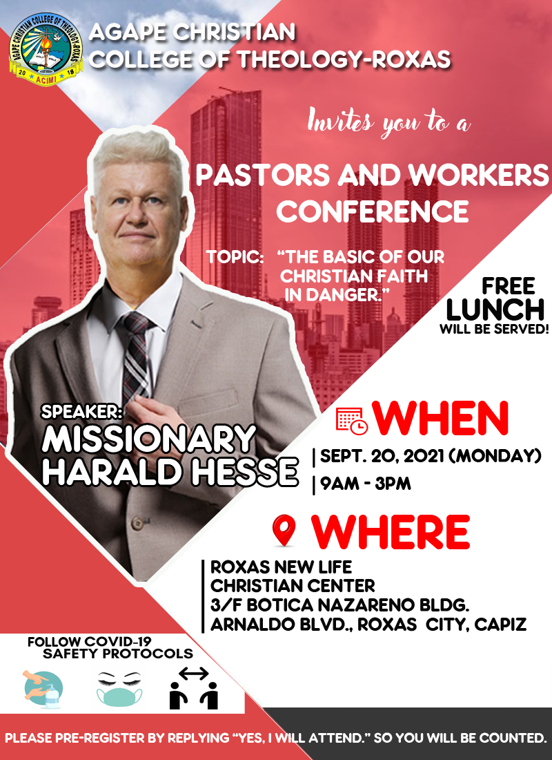
The Basic of our
Christian Faith in Danger
I think they will kill me for this one
OCT 04 2021 (MONDAY)
9AM – 3PM
SEP 27 2021 (MONDAY)
9AM – 3PM

Slide 2
Bibliology
Scripture research Part of Archaeology

Slide 3


Slide 4
Strong Delusions
[KJV+] 2Th 2:11
And for this cause God shall send them strong delusion, that they should believe a lie

Slide 5
Strong Delusions
[KJV+] 2Th 2:
3 Let no man deceive you by any means: for , except there come a falling away first, and that man of sin be revealed, the son of perdition;
4 Who opposeth and exalteth himself above all that is called God, or that is worshipped; so that he as God sitteth in the temple of God, shewing himself that he is God.
5 Remember ye not, that, when I was yet with you, I told you these things?
6 And now ye know what withholdeth that he might be revealed in his time.
7 For the mystery of iniquity doth already work: only he who now letteth , until he be taken out of the way.

Slide 6
Strong Delusions
Strongs: G459 ὁ ἄνομος
1) destitute of (the Mosaic) law
1a) of the Gentiles
2) departing from the law, a violator of the law, lawless, wicked
[KJV+] 2Thess 2:
8 And then shall that Wicked be revealed, whom the Lord shall consume with the spirit of his mouth, and shall destroy with the brightness of his coming: 9 , whose coming is after the working of Satan with all power and signs and lying wonders, 10 And with all deceivableness of unrighteousness in them that perish; because they received not the love of the truth, that they might be saved. 11 And for this cause God shall send them strong delusion, that they should believe a lie: 12 That they all might be damned who believed not the truth, but had pleasure in unrighteousness.

Slide 7
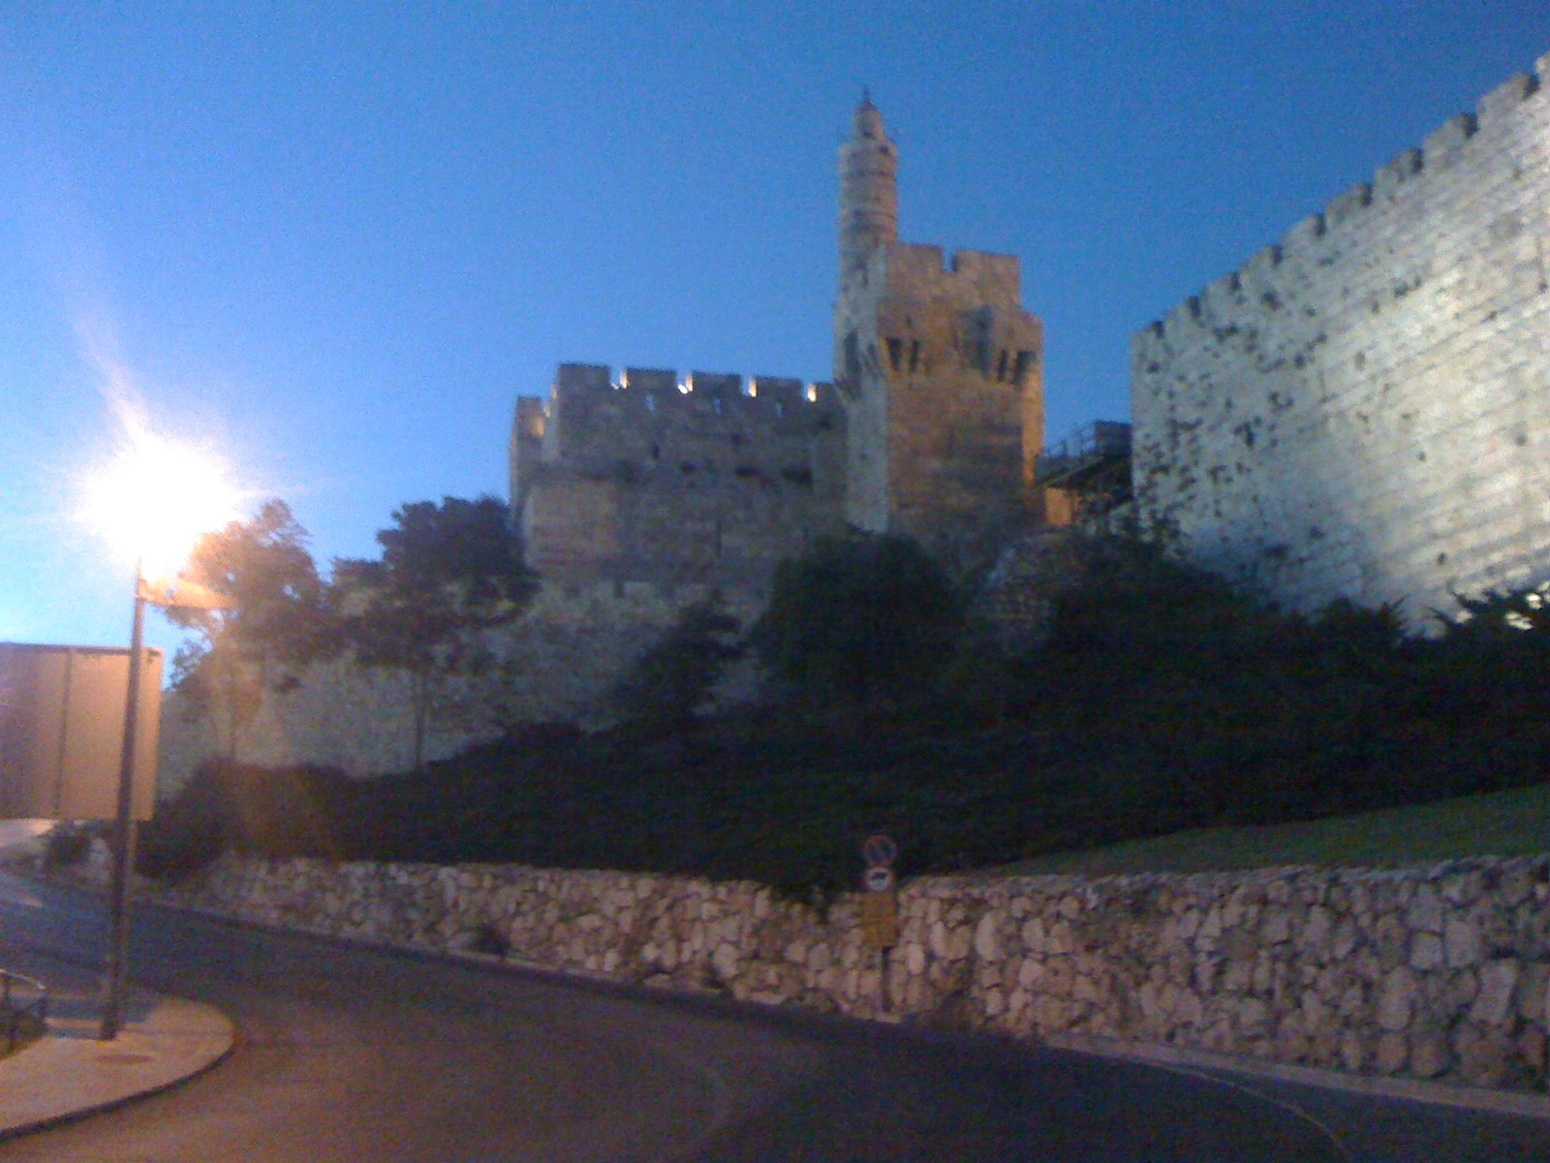
Have you been once in a dream and in the dream you dreamed a dream? This how I feel sometimes when I compare Bibles with the sources of scriptures.
Often you can only see the teaching that the translator has put in it and not Yeshua the King and you ask:
“Why is this so?”

Slide 8
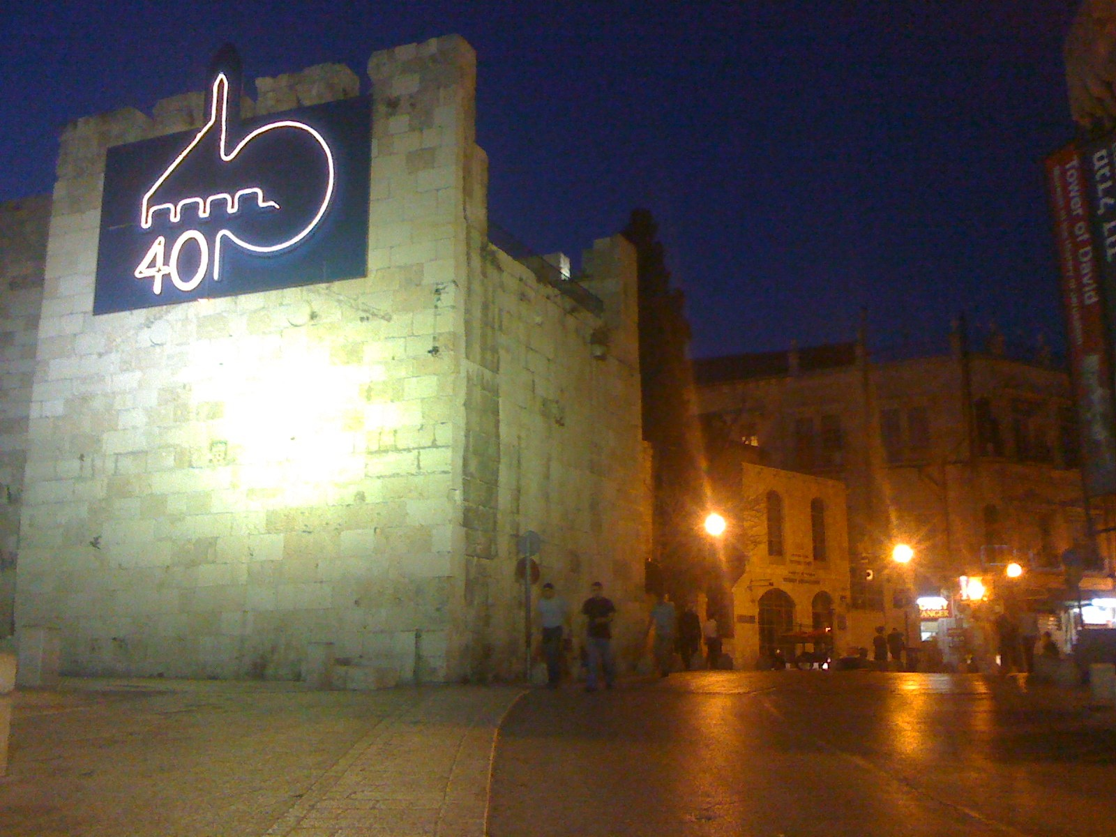
First you have a question to God then you look it up in the Bible then you are not satisfied because the spirit of God troubles you and you dig deeper. Compare it with other Bibles and it puzzles you more, you go down to the ancient text and there are also different once. Then where is the answer?

Slide 9
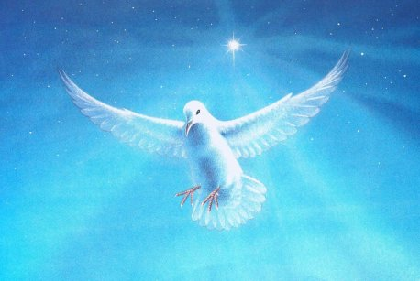
Jesus ???
dzjeesous
Where is your Deity, Name, Miracles,
Tanakh and it's fulfillments, Teaching
all is gone in the wind???

Slide 10
Revelation 22:18 For I testify unto every man that heareth the words of the prophecy of this book, If any man shall add unto these things, God shall add unto him the plagues that are written in this book:
19 And if any man shall take away from the words of the book of this prophecy, God shall take away his part out of the book of life, and out of the holy city, and the things which are written in this book.
20 He which testifieth these things saith, Surely I come quickly. Amen. Even so, come, Lord Jesus.
21 The grace of our Lord Jesus Christ with you all. Amen.
God shall add unto him the plagues that are written in this book:
Deuteronomy 4:2 Ye shall not add unto the word which I command you, neither shall ye diminish from it, that ye may keep the commandments of the LORD your God which I command you.
Deuteronomy 12:32 Proverbs 30:6 Matthew 15:9 But in vain they do worship me, teaching doctrines the commandments of men.

Slide 11
What does that mean?
Prepare for the last battle

Slide 12
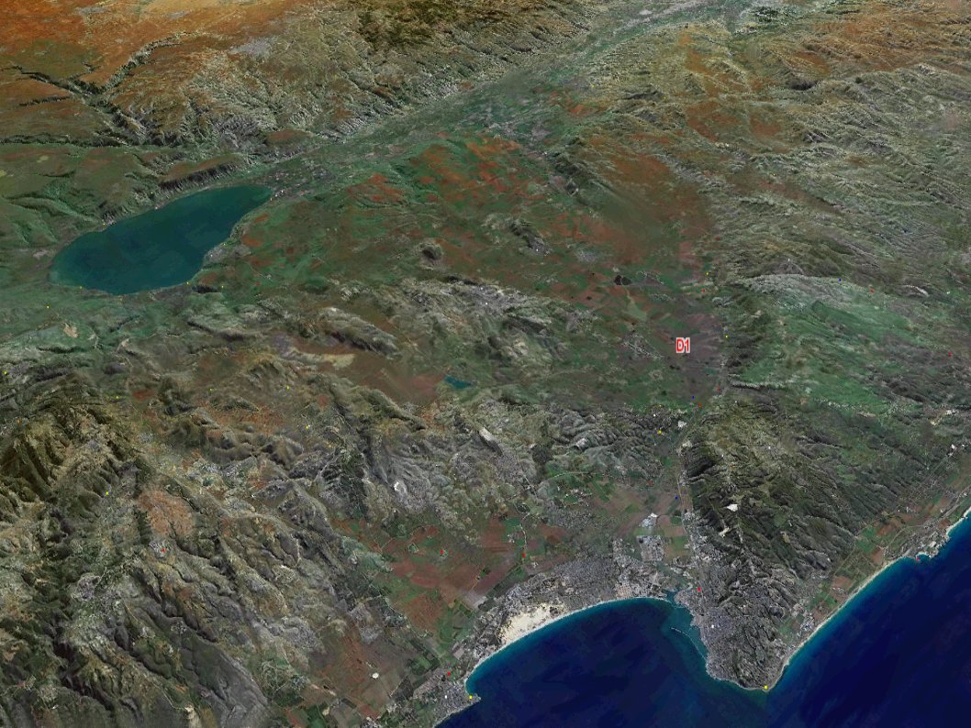
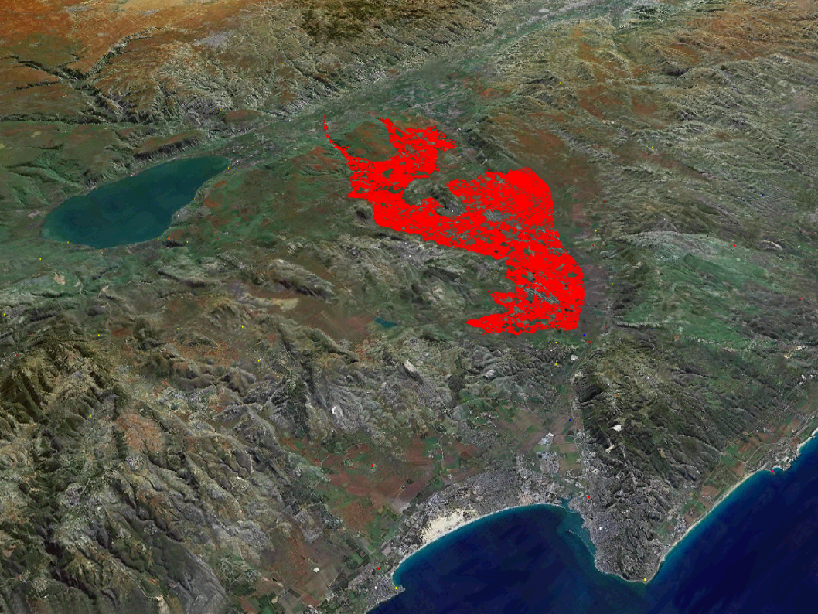

Slide 13
The last battle is about the word of God
like the serpent tempted Eve with the speech:
Yea, hath God said,
Ye shall not eat of every tree of the garden ???
Why was everything going so wrong???

Slide 14
Acts of the Apostles
What does Luke report?
Why are there only a few Apostles mentioned in Acts?
Why was Shme’on Kipha not mentioned in Rome???

Slide 15
Simon Magus
[KJV+] Acts 8:5 Then Philip went down to the city of Samaria, and preached Christ unto them.
6 And the people with one accord gave heed unto those things which Philip spake, hearing and seeing the miracles which he did.
7 For unclean spirits, crying with loud voice, came out of many that were possessed : and many taken with palsies, and that were lame, were healed.
8 And there was great joy in that city.

Slide 16
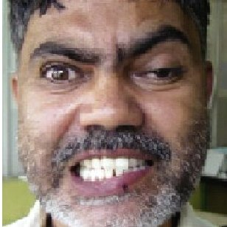
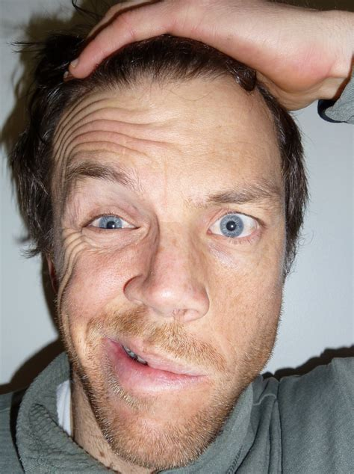

Palsy

Slide 17
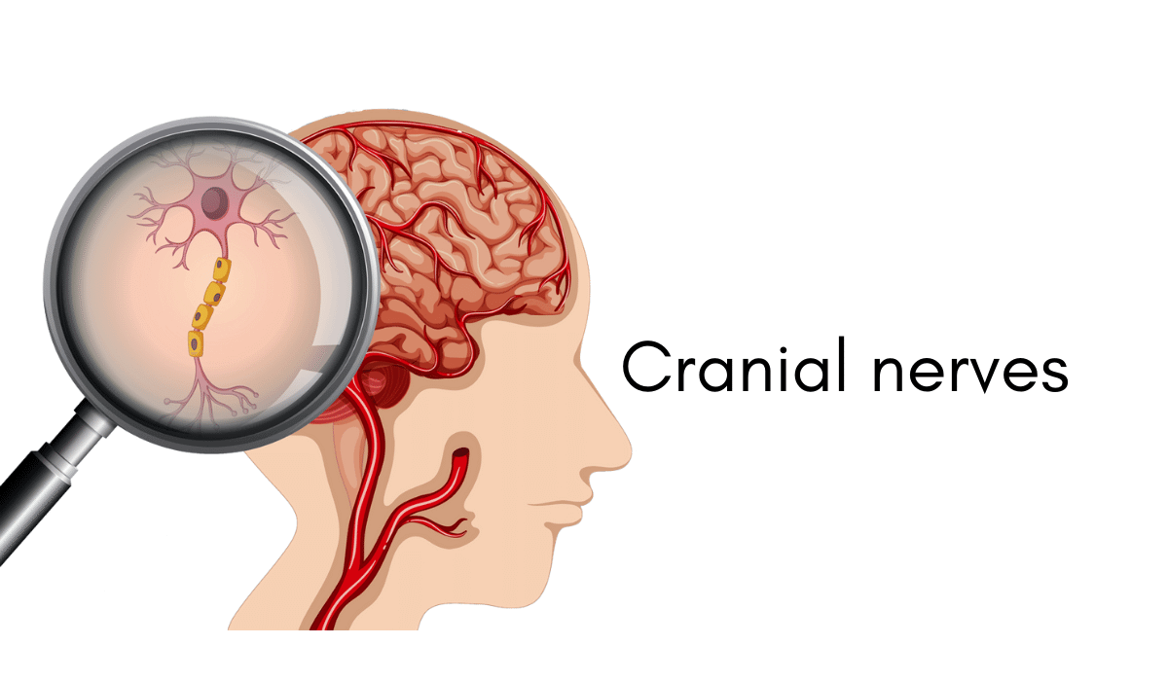
Palsy

Slide 18
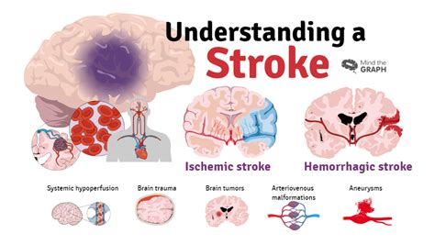
Lame

Slide 19
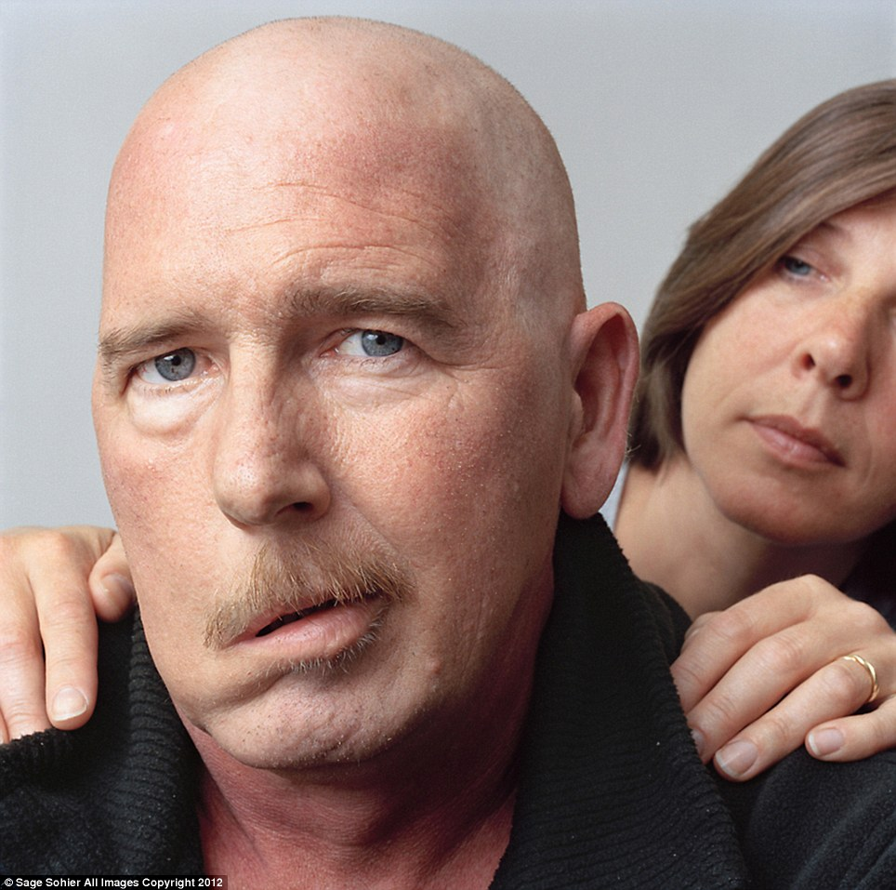
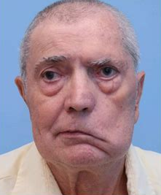
Lame

Slide 20


Slide 21
Simon Magus
[KJV+] Acts 8:9 But there was a certain man, called Simon, which beforetime in the same city used sorcery, and bewitched the people of Samaria, giving out that himself was some great one:
10 To whom they all gave heed, from the least to the greatest, saying, This man is the great power of God.
Σίμων

Slide 22
A Brief History of the Samaritans
There were originally five Babylonian tribes who had been transported to the area where Northern Israel once lived before Israel’s inglorious defeat and captivity by the Assyrians. When these five tribes moved INTO the vacant land of Samaria, they brought their Babylonian and Assyrian gods with them. After a short while in their new country, they were ravaged by lions. They interpreted this punishment as coming upon them because they failed to honor the god of the new land -- not realizing that there is only One Great GOD, who is not confined to any one land. These Samaritans didn't have sense enough to realize that the True God of the land had sent Israel into captivity because of their calf-worship and
their introduction of Phoenician religion..

Slide 23
A Brief History of the Samaritans
They asked the Assyrian king to send back one of the priests of Israel to teach them the former religion in order that the plague of lions would be stayed.
The Israelitish priest who was sent to them taught the religion of Northern Israel. Remember that the priests of Northern Israel were NOT Levites. At the time of Jeroboam, the true priests of YEHOVAH God were forced to flee to Jerusalem and Judea (II Chron. 11:14). Jeroboam set up his own form of religion with the calves at Dan and Bethel (I Kings 12:28-30). He moved the Holy Days from the seventh to the eighth month. He made priests of the lowest of the people, those who were NOT of Levi (I Kings 12:31).

Slide 24
A Brief History of the Samaritans
All of these acts of Jeroboam were outright violations of YEHOVAH’s law. It was from the time of Jeroboam down to the time of Israel’s captivity, that the majority of Israel was NOT worshipping the True God at all! Jerusalem and YEHOVAH’s temple had been repudiated, and paganism had been introduced on a grand scale. When these transplanted Babylonians who were being afflicted by lions in Samaria asked for a priest of the former people -- THEY GOT ONE!
But that priest was one of the former calf-worshipping priests of the rebel Israelites. He was almost as pagan as the Babylonians themselves! This priest of Israel taught the Babylonians (now called Samaritans) to
adopt the former worship of the Northern Israelites. The priest
taught them to revere YEHOVAH as the "God of the Land."

Slide 25
A Brief History of the Samaritans
Thus, these Samaritans finally took upon themselves the NAME: The People of YEHOVAH; but their religion was outright paganism -- a mixture of Israelitish calf-worship and Babylonianism -- just as Simon Magus later was eager to appropriate the Messiah’s NAME, but continue his pagan abominations!
Notice what YEHOVAH God says about the final condition of these Samaritans --
"So these nations feared the Lord [calling themselves YEHOVAH’s people], AND served their graven images, both their children, and their children’s children: as did their fathers [the Babylonians], so do they unto this day" (II Kings 17:41).
These people called themselves the worshippers of the True
God, but were actually Babylonian idolaters.

Slide 26
Simon Magus
[KJV+] Acts 8:
11 And to him they had regard, because that of long time he had bewitched them with sorceries.
12 But when they believed Philip preaching the things concerning the kingdom of God, and the name of Jesus Christ, they were baptized, both men and women.
13 Then Simon himself believed also: and when he was baptized, he continued with Philip, and wondered, beholding the miracles and signs which were done.
14 Now when the apostles which were at Jerusalem heard that Samaria had received the word of God, they sent unto them Peter and John:
15 Who, when they were come down, prayed for them, that they might receive the Holy Ghost:
16 (For as yet he was fallen upon none of them: only they were baptized in the name of the Lord Jesus.)
17 Then laid they hands on them, and they received the Holy Ghost.

Slide 27
Simon Magus
[KJV+] Acts 8:18 And when Simon saw that through laying on of the apostles' hands the Holy Ghost was given, he offered them money,
19 Saying, Give me also this power, that on whomsoever I lay hands, he may receive the Holy Ghost.
20 But Peter said unto him, Thy money perish with thee, because thou hast thought that the gift of God may be purchased with money.
21 Thou hast neither part nor lot in this matter: for thy heart is not right in the sight of God.
22 Repent therefore of this thy wickedness, and pray God, if perhaps the thought of thine heart may be forgiven thee.
23 For I perceive that thou art in the gall of bitterness, and the bond of iniquity.
24 Then answered Simon, and said, Pray ye to the Lord for me, that none of these things which ye have spoken come upon me.
The translation must be: For I perceive that you are for gall of bitterness Deu 29:16-18
It is a prophetic message! Shme’on received a revelation “I perceive”
Notes:
Lest there should be among you man, or woman, or family, or tribe, whose heart turneth away this day from the LORD our God, to go and serve the gods of these nations; lest there should be among you a root that beareth gall and wormwood; ¹⁹ Deuteronomy 29:18-19

Slide 28
Elymas the sorcerer
Act 13
Cyprus → Salamis →Paphos →
a certain sorcerer,
a false prophet,
a Jew,
whose name BarJesus:

Slide 29
Simon Magus
Born and raised in Samaria with a Babylonian religion mixed with the 5 books of Moses
Studied in Qumran under Jokhanan Ben Sacharia (John the Baptist)
Went to Egypt and Studied Mysteries Magic and Sorcery in Alexandria
  ( [KJV+] 2Tim 3:8 Now as Jannes and Jambres withstood Moses, so do these also resist the truth: men of corrupt minds, reprobate concerning the faith.)
Went back to Samaria and became famous
Met Apostle Philip
Believed and was baptized
Met Apostle Shime’on Kipha
Tried to buy apostleship and the holy spirit
Was rebuked and rejected by Shime’on Kipha
Went to Rome beguiled Tiberius Caesar, Gaius, Tiberius Claudius and Ceasar Nero
Became famous in Rome and the founder of the Roman church
Christians were persecuted
Paul was beheaded

Slide 30
Why is God
not judging Babylon
straight away?

Slide 31
Mercy towards the remaining righteous
Sin is not full yet
A call for those righteous to come out like Lot needs to come first

Slide 32
Translation | Short sign | Ignoration of the Textus Receptus
New King James Version | NKJV | 1200
New American Standard | NAV | 909
Revised Version | RV | 788
New World Translation | NWT | 767
New International Version | NIV | 695
Good News | GN | 614
Amplified | AMP | 484
Douay | DOU | 421
Old Jehovah Witnesses | OJW | 120

Slide 33
Verse | Text King James Version | Tischendorff
Mt 17:21 | Howbeit this kind goeth not out but by prayer and fasting. | Omitted
Mt 18:11 | For the Son of man is come to save that which was lost. | Omitted
Mt 23:14 | Woe unto you, scribes and Pharisees, hypocrites! for ye devour widows' houses, and for a pretence make long prayer: therefore ye shall receive the greater damnation. | Omitted
Mk 7:16 | If any man have ears to hear, let him hear. | Omitted
Mk 9:29 | And he said unto them, This kind can come forth by nothing, but by prayer and fasting. | and fasting. Omitted
Mk 9:44 | Where their worm dieth not, and the fire is not quenched. | Omitted
Mk 9:46 | Where their worm dieth not, and the fire is not quenched. | Omitted
Mk 11:26 | But if ye do not forgive, neither will your Father which is in heaven forgive your trespasses. | Omitted

Slide 34
Verse | Text King James Version | New Age Bibles
Mk 15:28 | And the scripture was fulfilled, which saith, And he was numbered with the transgressors. | Omitted
1Joh 5:7 | Take ye heed, watch and pray: for ye know not when the time is. | Take ye heed, watch and pray: Omitted
2Cor 6:5 | In stripes, in imprisonments, in tumults, in labours, in watchings, in fastings; | sleepless nights and hunger;
2Cor 11:27 | that ye may give yourselves to fasting and prayer; and come together again, | Fasting omitted
Lk 4:4 | It is written, That man shall not live by bread alone, but by every word of God | every word of God omitted
1Peter 2:2 | As newborn babes, desire the sincere milk of the word | of the word omitted

Slide 35
Not
ANTI-Jesus but ANTI-CHRIST

Slide 36
KJV | Verse | NIV
Is not this the Christ | John 4:29 | This is not the Christ is it?
Christ Jesus | Acts 19:4 | Jesus
Jesus Christ | 1Cor 9:1 | Jesus
Jesus Christ | 1John 1:7 | Jesus
Jesus Christ | Rev 1:7 | Jesus
Jesus Christ | Rev 1:9 | Jesus
Christ Jesus | Heb 3:1 | Jesus
Christ | Acts 9:20 | Jesus
Thou art the Christ | John 6:69 | Omitted

Slide 37
Acts 15:14
KJV
Simeon
New Age Bibles
Simon

Slide 38
Transscription
ויזעק שנים עשר תלמידיו ויתן להם
ממשלה על רוחות טמאות להוציא
אתהן ולרפא את כל חלי ומכאוב
ושמות השנים עשר שליחים אלה הם הראשון
שמעון שנקרא כיפא ואנדריאה אחיו פיליפוס
וברטולומיאו יעקב זבדי ויוחנן אחיו תומאסו
ומטיאו שהיה בעל עבירה ויעקב אלפי ותדיאו
שמען הכנעי ויהודה איסכריאטו אשר מסר
אותו למיתה וישלח ישו את אלה השנם עשר

Slide 39
Translation
And when he had called unto him his twelve Talmidio (Disciples),
he gave them power against unclean spirits, to cast them out,
and to heal all manner of sickness and all manner of disease.
Now the names of the twelve Shelichim (Apostles) are these;
The first, Simeon, who is called Kipha (Peter), and Andriah (Andrew) his brother;
Philipus (Philip), and Bartolomaeo (Bartolomaeus);
Yakob (James) the son of Zeb'dee, and Jochanan (John) his brother;
Tomaso, and Matthaeo (Matthew) the publican;
Yakob (James) the son of Alfi, and Thaddaeo (Thaddaeus);
Shimon (Simon) the Cana'ai, and Yehuda (Judas) Iskariot, who also betrayed him.

Slide 40
KJV | Verse | NIV
I can do all things through Christ which strengtheneth me. | Philippians 4:13 | I can do all this through him who gives me strength.
KJV For I am not ashamed of the gospel of Christ: | Romans 1:16 | For I am not ashamed of the gospel, omitted

Slide 41
KJV | Verse | New Age Bibles
Lord Jesus Christ | Acts 15:11 | Lord Jesus / making ancestors saved
Lord Jesus Christ | Acts 16:31 | Lord Jesus
Jesus Christ our Lord | Rom 1:3 | omitted
Lord Jesus Christ | 2 Cor 11:31 | Lord Jesus
Jesus Christ our Lord | 1Thess 3:11 | Jesus our Lord
Our Lord Jesus Christ | 2Thess 1:3 | our Lord Jesus
Our Lord Jesus Christ | 2Thess 1:12 | our Lord Jesus
In the name of our Lord Jesus Christ | 1Cor 5:4 | Omitted
Our Lord Jesus Christ | Eph 3:14 | Omitted
with all saints | Eph 3:18 | with all the Lord’s holy people,
And to know the love of Christ | Eph 3:19 | and to know this love that surpasses knowledge

Slide 42
36b See, here is water; what doth hinder me to be baptized? 37 And Philip said, If thou believest with all thine heart, thou mayest. And he answered and said, I believe that Jesus Christ is the Son of God.
Acts 8:37

Slide 43
KJV | Verse | New Age Bibles
an heir of God through Christ. | Gal 4:7 | God has made you also an heir.
God who created all things by Jesus Christ | Eph 3:9 | God who created all things
the whole family in heaven | Eph 3:14 | every family in heaven
To the saints and faithful brethren in Christ which are at Colosse: Grace be unto you, and peace, from God our Father and the Lord Jesus Christ | Col 1:2 | To God’s holy people in Colossae, the faithful brothers and sisters in Christ:
Son of GOD | John 9:35 | Son of Man
that Christ the son of the living GOD | John 6:69 | the Holy one of God

Slide 44
KJV
And every spirit that confesseth not that Jesus Christ is come in the flesh is not of God: and this is that spirit of antichrist,
1 John 4:3
NIV
but every spirit that does not acknowledge Jesus is not from God. This is the spirit of the antichrist,
1 John 4:3
Evil Spirits believe (Jam 2,19) in Jesus but they do not confess
that Jesus Christ is come in the flesh

Slide 45
KJV | Verse | New Age Bibles
His son Jesus | Acts 3:13 | His servant Jesus
His son Jesus | Acts 3:26 | His servant Jesus
Holy child Jesus | Acts 4:27 | Holy servant Jesus
Holy child Jesus | Acts 4:30 | Holy servant Jesus
The firstborn of every creature | Col 1:15 | The firstborn of all creation
Jesus | Mark 2:15 | Omitted
Jesus | Heb 4:8 | Joshua
Jesus | Acts 7:45 | Joshua
the patient waiting for Christ. | 2Thess 3:5 | Christ’s perseverance.

Slide 46
KJV | Verse | New Age Bibles
Godhead | Acts 17:29 | Devine nature
God and our father | Phil 4:20 | Our God and father
God and his father | Rev 1:6 | His God and father
God and the father by him | Col 3:17 | God the father through him
Comforter | John 14:16 | Helper
Comforter | John 14:26 | Helper
Comforter | John 15:26 | Helper
Comforter | John 16:7 | Helper

Slide 47
KJV
A little while, and ye shall not see me: and again, a little while, and ye shall see me, because I go to the Father.
And were continually in the temple, praising and blessing God. Amen.
And without controversy great is the mystery of godliness: God was manifest in the flesh…
but he that came down from heaven, even the Son of man which is in heaven.
Verse
John 16:16
Luke 24:53
Mark 16:9
1Tim 3:16
John 3:13
New Age Bibles
because I go to the Father. Omitted
and blessing God. Amen. Omitted
[The earliest manuscripts and some other ancient witnesses do not have verses 9–20.]
He instead of GOD
which is in heaven. omitted

Slide 48
KJV | Verse | NIV
For we are members of his body, of his flesh, and of his bones. | Eph 5:30 The Spirit of NIV does not confess that Jesus who is GOD came in flesh | for we are members of his body………………………………… …...

Slide 49
KJV | Verse | NIV
A little while, and ye shall not see me: and again, a little while, and ye shall see me, because I go to the Father. | Joh16:16 NIV Omits because I go to the Father | Jesus went on to say, “In a little while you will see me no more, and then after a little while you will see me.”

Slide 50
Introduction
When Eberhard Nestle, in 1898, presented the first edition of the Novum Testamentum Greace, he had achieved a work of which the consequenses were not only unknown to him at the time, but also to the Würtenberg Bible Society that made the edition possible. If the Textus receptus at that time still had a number of defenders, the science of the 19th century had however, finally proved it to be the worst text of the New Testament. There the edition of Tischendorf (since 1841, the finalized edition of editio octava critica maior of 1869/72, Tregelles (1857/72) and Westcott/Hort (1881) controlled the field.

Slide 51
But in the practiced terms at the level of university, church and school, the edition of the Textus receptus was still largely used internationally as for example by the British Bible Society till 1904. Only with the release of the Nestle Text did the rule of the Textus receptus come to an end here also.

Slide 52
Manuscripts
Alexandrian Texts
abbreviations of original
Traditional Texts
nearly identical
Western Texts
expansions of original
Papyrus 66
ca. 200 AD
Mixed Text
Peshitta
Syriac
2nd Century
Papyrus 75
ca. 200 AD
Gothic Version
4th Century
Old Latin 2nd Century
Latin Vulgate 4th Century
Codex B
4th Century
Codex א 4th Century
Codex W
(Matthew)
4th - 5th Century
Codex A
5th Century
Codex D 5th 6th Century
Revised Version
1881
Codex D2 6th Century
A Great Majority of Copies of NT Manuscripts
American Standard Version
1961
Codex E2 7th Century
Revised Standard Version
1946
New English Bible
1961
King James
Version 1611
Douay Version 1582

Slide 53
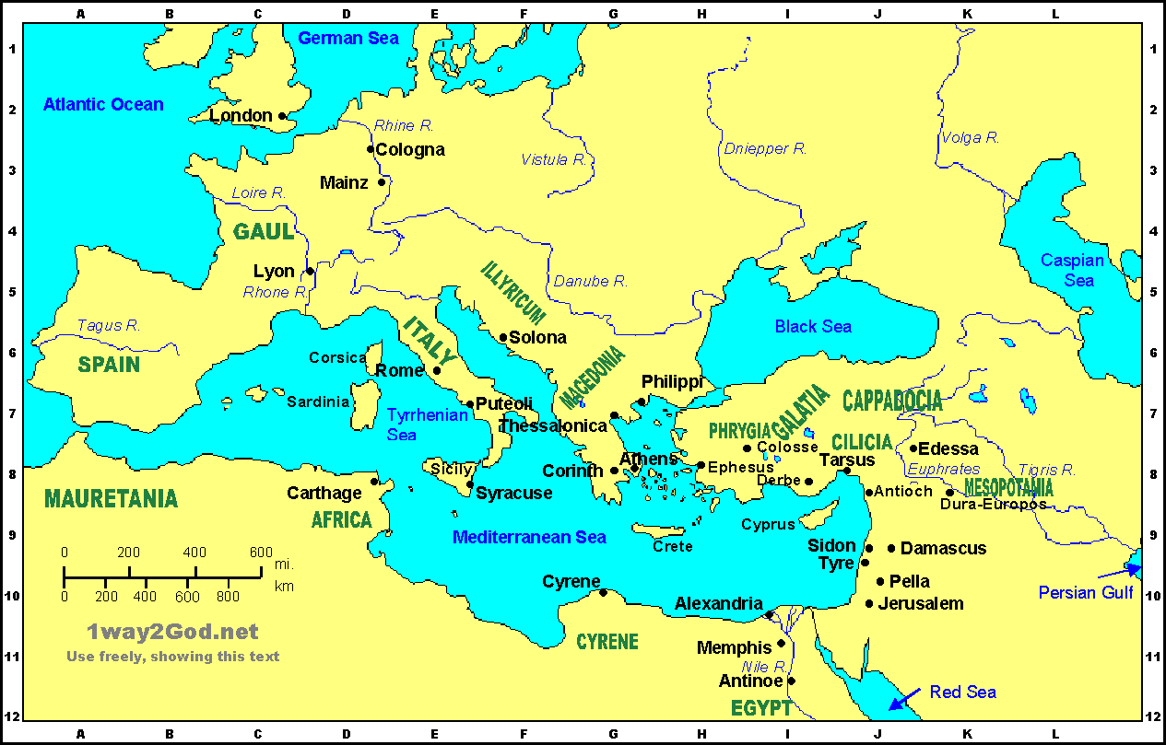

Slide 54
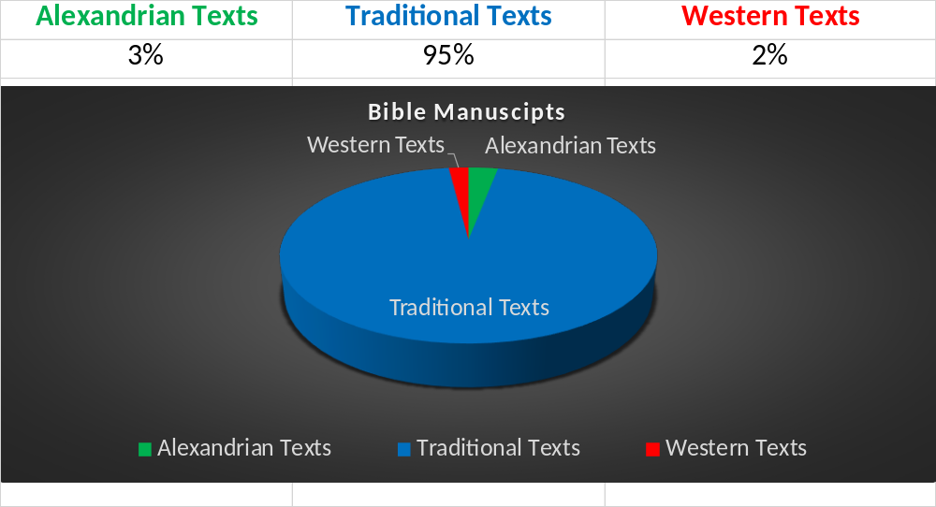

© Harald Hesse 2021
5309 Manuscipts
Counted before Qumran

Slide 55
Codex Sinaiticus
The torn condition of many folios, the ghostly traces of
the text overlaid by the later one made the decipherment an extremely difficult task. Even with modern aids like ultra-violet photography, not all the text is securely legible.
The codex measures 12 1/4 in/31.4-32.5 cm by 9 in/25.6-26.4 cm, with a single column to a page. Originally the whole Bible seems to have been contained in it.
William Henry Hatch, The Principal Uncial Manuscripts Of The New Testament,
The University of Chicago Press, Chicago, 1939.

Slide 56
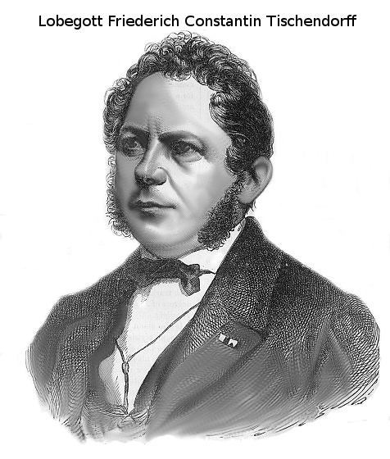
His name was
Lobegott Friederich Constantin
von Tischendorff
Praise GOD and rich of Peace
(*18. Jan 1815 in Lengenfeld; †7. Dec 1874 in Leipzig)
but He cancelled it to exalt himself
from rubbish he deceived
People to believe not any longer
the truth. What he could not see with his eyes he wrote down to support what he knew was not to be found. He covered the
evil that was also found in
the Codex Sinaiticus
«to take the mark of the beast»
If he would have been honest...

Slide 57
John Burgon, “The Revision Revised”
It is clear that the scribes who copied the Codex Sinaiticus were not faithful men of God who treated the Scriptures with utmost reverence. The total number of words omitted in the Sinaiticus in the Gospels alone is
compared to the Greek Received Text (Burgon, p. 75).
3,455

Slide 58
Of these about 5,309 existing manuscripts, over 95% are in total agreement with, and form the basis for the Textus Receptus, which is the text which the King James translators used.
Type of Manuscript | Total number of this type of manuscript | Number that support Westcott & Hort | Number that support Textus Receptus
Papyrus | 88
Unical | 267
Cursive | 2764
Lectionary | 2143
13 (15%) | 75 (85%)
9 (3%) | 258 (97%)
23 (1%) | 2741 (99%)
0 | 2143 (100%)

Slide 59
John 1:1-5 Unical Koine GREEK | Classical Greek accented | Modern Greek
En arxh hn o logos kai o logos hn pros ton qeon kai qeos hn o logos outos hn en arxepros ton qeon panta di autou egeneto kai xorisautou egeneto oude en o gegonen En auto zwe hn kai h zwe hn to fws ton anqrwpwn Kaito fws en th scotia fainei kai h scotia auto ou katelaben | ​ ¹ Ἐν ἀρχῇ ἦν ὁ λόγος, καὶ ὁ λόγος ἦν πρὸς τὸν θεόν, καὶ θεὸς ἦν ὁ λόγος. ² Οὗτος ἦν ἐν ἀρχῇ πρὸς τὸν θεόν. ³ Πάντα δι᾽ αὐτοῦ ἐγένετο, καὶ χωρὶς αὐτοῦ ἐγένετο οὐδὲ ἓν ὃ γέγονεν. ⁴ Ἐν αὐτῷ ζωὴ ἦν, καὶ ἡ ζωὴ ἦν τὸ φῶς τῶν ἀνθρώπων, ⁵ καὶ τὸ φῶς ἐν τῇ σκοτίᾳ φαίνει, καὶ ἡ σκοτία αὐτὸ οὐ κατέλαβεν. | Εν αρχη ην ο λογος και ο λογος ην προς τον θεον και θεος ην ο λογος 2 ουτος ην εν αρχη προς τον θεον 3 παντα δι αυτου εγενετο και χωρις αυτου εγενετο ουδε εν ο γεγονεν 4 εν αυτω ζωη ην και η ζωη ην το φως των ανθρωπων 5 και το φως εν τη σκοτια φαινει και η σκοτια αυτο ου κατελαβεν

Slide 60
Alexandria and their library was famous for the collection of books of old times especially in Astrology and witch craft. It was burned down (and Christians were blamed for it) about the 6th Century because of this aggressive evil.

Slide 61
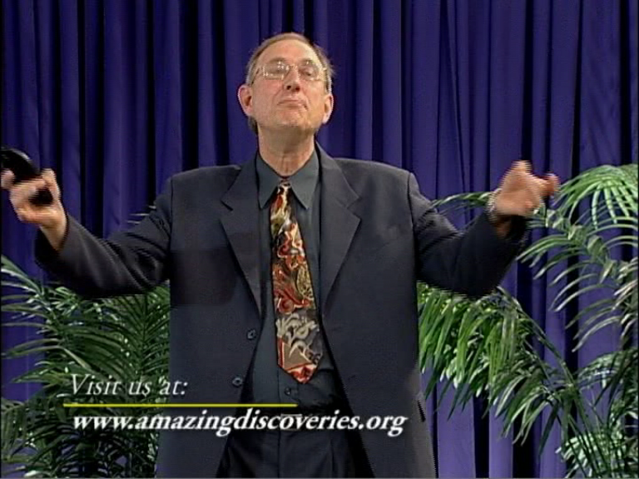
© Harald Hesse 2021
Notes:
Prof. Dr. Walter Veith
University of South Africa Pretoria

Slide 62
The received text (Textus Recepticus «TR») is
the old Byzantine text with 1900 copies in agreement. It was written in Koine Greek of which hundreds of words cannot be translated into classical Greek. The early church used Koine Greek manuscripts and rejected the Alexandrian versions which were based on corrupt version with Origen and other Gnostic revisions.
Origen taught that Jesus was a created being who did not have eternal existence as God.
(Encyclopedia Britannica, vol. 16, 1936, page 900-902)

Slide 63
O Timothy, keep that which is committed to thy trust, avoiding profane vain babblings, and oppositions of science falsely so called: Which some professing have erred concerning the faith. Grace with thee. Amen.
γνωσις
1 Timothy 6:20-21

Slide 64
How early started the deception?
In the Apostles time?
In the Apostolic fathers time?
In the Church fathers time?

Slide 65
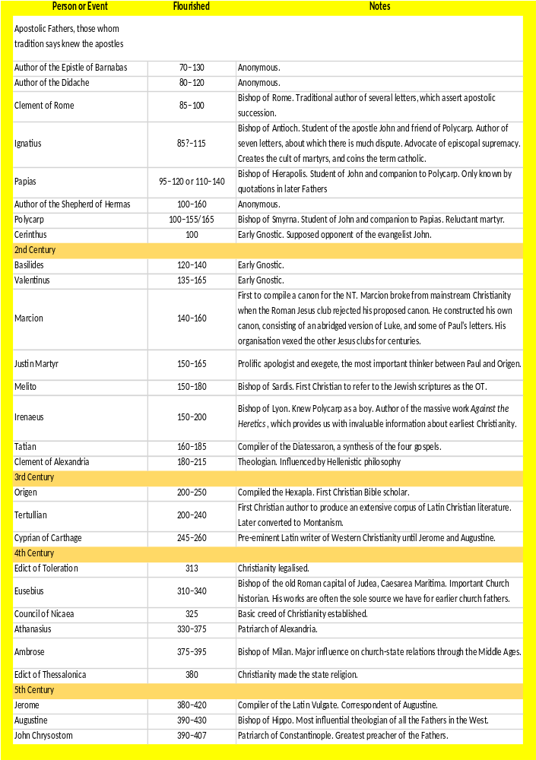

Slide 67
About early church
This doctrine of transmigration of souls obtained, as Porphyry informs us, among the Persians and the Magi. It was held in the East and the West and that from the remotest antiquity. Herodotus found it among the circle of migrations from one human body, through animals, fishes, and birds, to another human body three thousand years.... The Curds, the Chinese, the Kaballists, all held the same doctrine. So Origen held, and Bishop Synesius, the latter of whom had been initiated, and who thus prayed to God: «O Father, grand that my soul, reunited to the light, may not be plunged again into the defilements of earth!» So the Gnostics held; and even the Disciples of Christ inquired if the man who was born blind, was not so punished for some sin that he had committed before his birth.
Morals and Dogma, page 399
© Harald Hesse 2021

Slide 68
John 9:2
And his disciples asked him, saying, Master, who did sin, this man, or his parents, that he was born blind?

Slide 69
A sin before birth is not mentioned
His soul was not migrating from his parents, since they were still alive while he was born.
Migration of souls does not work if there is a growing society. Where would the new souls come from?
Yeshua made sure not every sin leads to a genetic failure.
It was to manifest the works of GOD

Slide 70
Origenus, born A.D. 134 or 135,
“Answering Celsus”, who had objected that the Christians had a concealed doctrine said: «Inasmuch as the essential and important doctrines and the principles of Christianity are openly taught, it is foolish to object that there are other things that are recondite; for this is common to Christian discipline with that of those philosophers in whose teaching some things were exoteric and some esoteric: and it is enough to say that it was so with some of the disciples of Pythagoras:»
Morals and Dogma. page 544
© Harald Hesse 2021

Slide 71
Origenus gives much information as to the Mysteries of the Ophites; and there is no doubt that all the Gnostic sects had Mysteries and initiation. They all claimed to possess a secret doctrine, coming to them directly from Jesus Christ, different from that of the Gospels and Epistles, and Superior to those communications, which in their eyes, were merely exoteric.
Morals and Dogma, page 542

Slide 72
The Mysteries were open to the Fideles or Faithful only: and no spectators were allowed at the communion.
Tertullian, who died about A.D. 216, says in his Apology: «None are admitted without an oath of secrecy. We appeal to our Thracian and Eleusinian Mysteries: and we are especially bound to this caution, because if we prove faithless, we should not only provoke Heaven but draw upon our heads the utmost rigor of human displeasure. And should strangers betray us? They know nothing but by report and hearsay. Far hence, ye Profane! Is the prohibition from all holy Mysteries.»
Clemens Bishop of Alexandria, born about A.D.191, says in his Stromata, that he cannot explain the Mysteries, because he should thereby, according to the old proverb, put a sword into the hands of a child.
Morals and Dogma, page 544
© Harald Hesse 2021

Slide 73
Cyril, Bishop of Jerusalem, was born in the
year 315 and died in 386. In his Catechesis he says: «The Lord spake in parables to His hearers in general; but to His disciples He explained in private the parables and allegories which He spoke in public. The splendor of glory is for those who are early enlightened: obscurity and darkness are the portions of the unbelievers and ignorant. Just so the church discovers its Mysteries to those who have advanced beyond the class of Catechumens: we employ obscure terms with others.» Morals and Dogma, page 545
© Harald Hesse 2021

Slide 74
Matthew 13:35
That it might be fulfilled which was spoken by the prophet, saying, I will open my mouth in parables; I will utter things which have been kept secret from the foundation of the world.

Slide 75
For the first comming of Yeshua things were uttered that were kept secret from the foundation of the world.
For His second comming things will be talked about the creation of the world for believers to stengthen their faith and to mature them.
He answered and said unto them, Because it is given unto you to know the mysteries of the kingdom of heaven, but to them it is not given. Mt 13:10

Slide 76
St. Augustinus, Bishop of Hippo, was
born in 347 and died in 430, says in one of his
discourses: «Having dismissed the Catechumens, we
have retained you only to be our hearers; because besides those things which belong to all Christians in common, we are now to discourse to you of sublime Mysteries, which none are qualified to hear, but those who by Master's favor are made partakers of them ... To have taught them openly, would have been to betray them.»
St. Chrysostomus and St. Augustinus speaks of initiation more than fifty times. St. Ambrosius writes to those who are initiated; and initiation was not merely baptism, or admission into the church, but it referred to initiation into the Mysteries.
Morals and Dogma, page 546
© Harald Hesse 2021

Slide 77
Augustinus was more influenced by philosophers then the bible by own choice. Non of them where believing in Yeshua or the Divinity of HIM
Aristoteles
Marcus Tullius Cicero (Favorit Autor)
Varro
Porphyry
Tertullian
Clemens von Alexandrien
Lactantius
Eusebius von Cäserea
H. Hagendahl, Augustine and the Latin Classics II: Augustine’s attitude, in Studia Greaca et Latina Gothoburgensia 20/2 [Stockholm: Almquist & Wiksell, 1967], 56
P. Courcelle, Late Latin writers and their greek sources, transl. H. E. Wedeck (Cambridge, Mass.: Harvard University Press, 1969)
© Harald Hesse 2021

Slide 78
Isaiah 45:19 I have not spoken in secret, in a dark place
of the earth: I said not unto the seed of Jacob, Seek ye me in vain: I the LORD speak righteousness, I declare things that are right.
Isaiah 48:16 Come ye near unto me, hear ye this; I have not spoken in secret from the beginning; from the time that it was, there I: and now the Lord GOD, and his Spirit, hath sent me.
Amos 3:7 Surely the Lord GOD will do nothing, but he revealeth his secret unto his servants the prophets.

Slide 79
Mark 4:22 For there is nothing hid, which shall not be manifested;
neither was any thing kept secret, but that it should come abroad.
Luke 8:17 For nothing is secret, that shall not be made manifest; neither hid, that shall not be known and come abroad.
Luke 11:33 No man, when he hath lighted a candle, putteth in a secret place, neither under a bushel, but on a candlestick, that they which come in may see the light.
John 7:4 For no man doeth any thing in secret, and he himself seeketh to be known openly. If thou do these things, shew thyself to the world.

Slide 80
Jesus answered him, I spake openly to the world; I ever taught in the synagogue, and in the temple, whither the Jews always resort; and in secret have I said nothing.
John 18:20

Slide 81
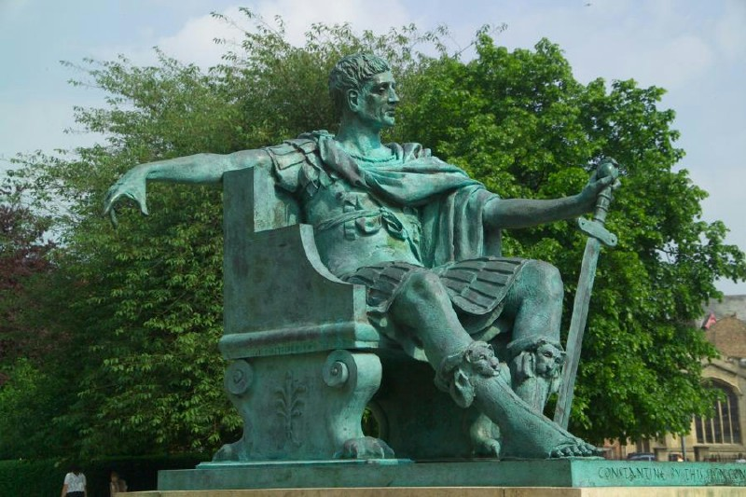
Romans
© Harald Hesse 2021

Slide 82
Revelation 22:18 For I testify unto every man that heareth the words of the prophecy of this book, If any man shall add unto these things, God shall add unto him the plagues that are written in this book:
19 And if any man shall take away from the words of the book of this prophecy, God shall take away his part out of the book of life, and out of the holy city, and the things which are written in this book.
20 He which testifieth these things saith, Surely I come quickly. Amen. Even so, come, Lord Jesus.
21 The grace of our Lord Jesus Christ with you all. Amen.

Slide 83
Romans
List of Roman battles
4th century
312 - Battle of Turin - Constantine I defeats forces loyal to Maxentius.
    Battle of Verona - Constantine I defeats more forces loyal to Maxentius.
October 28 - Battle of Milvian Bridge - Constantine I defeats Maxentius and takes control of Italy.
313, 30 April - Battle of Tzirallum - In the eastern part of the Empire, the
    forces of Licinius defeat Maximinus.
314 - 8 October - Battle of Cibalae - Constantine defeats Licinius
316 - Battle of Mardia - Constantine again defeats Licinius, who cedes
    Illyricum to Constantine.
© Harald Hesse 2021

Slide 84
Romans
List of Roman battles
324 - July 3 - Battle of Adrianople - Constantine defeats Licinius, who flees to
  Byzantium July - Battle of the Hellespont – Flavius Julius Crispus, son of
  Constantine, defeats the naval forces of Licinius
September 18 - Battle of Chrysopolis - Constantine decisively defeats Licinius, establishing his sole control over the empire.
344 - Battle of Singara - Emperor Constantius II fights an indecisive battle against King Shapur II of Persia (approximate date)
351 - Battle of Mursa Major - Emperor Constantius II defeats the usurper
  Magnentius
353 - Battle of Mons Seleucus - Final defeat of Magnentius by Constantius II
356 - Battle of Reims - Caesar Julian is defeated by the Alamanni
© Harald Hesse 2021

Slide 85
Romans
List of Roman battles
357 - Battle of Strasbourg - Julian expels the Alamanni from the Rhineland
359 - Battle of Amida - Persians capture Amida from Romans
363 - Battle of Ctesiphon - Emperor Julian defeats Shapur II of Persia outside the walls of the Persian capital, but is unable to take the city, and his death leads to an ultimate disaster on the retreat back to Roman territory.
366 - Battle of Thyatira - The army of the Roman emperor Valens
defeats the usurper Procopius.
367 - Battle of Solicinium - Romans under Emperor Valentinian I defeat yet another Alamanni incursion.
377 - Battle of the Willows - Roman troops fight an inconclusive battle against the Goths
© Harald Hesse 2021

Slide 86
© Harald Hesse 2021
Romans
List of Roman battles
378 - Battle of Argentovaria - Western Emperor Gratianus is victorious over the
    Alamanni, yet again.
    August 9 - Battle of Adrianople - Thervings under Fritigern defeat and kill the Eastern Emperor Valens
388 - Battle of the Save - Emperor Theodosius I defeats the usurper Magnus
    Maximus.
394 - September 6 - Battle of the Frigidus - Theodosius I defeats and kills the usurper Eugenius and his Frankish magister militum
    Arbogast.
The end of the Roman Empire came when in 450 A.D. the German tribes attacked with their swift ships over all the rivers and the sea all that what was Rome and finished their dominion

Slide 87
[KJV+] Act 13:42 And when the Jews were gone out of the synagogue, the Gentiles besought that these words might be preached to them the next sabbath.
[NIV] Act 13:42 As Paul and Barnabas were leaving the synagogue, the people invited them to speak further about these things on the next Sabbath.
[TR+] Act 13:42 εξιοντων δε εκ της συναγωγης των ιουδαιων παρεκαλουν τα εθνη εις το μεταξυ σαββατον λαληθηναι αυτοις τα ρηματα ταυτα
[TISGNT+] Act 13:42 Ἐξιόντων δὲ αὐτῶν παρεκάλουν εἰς τὸ μεταξὺ σάββατον λαληθῆναι αὐτοῖς τὰ ῥήματα ταῦτα.

Slide 88
[KJV] Mar 7:19 Because it entereth not into his heart, but into the belly, and goeth out into the draught, purging all meats?
[NIV] Mar 7:19 For it doesn’t go into their heart but into their stomach, and then out of the body.” (In saying this, Jesus declared all foods clean.) Mark 7:19
Mar 7:19
[TR+] οτι ουκ εισπορευεται αυτου εις την καρδιαν αλλ εις την κοιλιαν και εις τον αφεδρωνα εκπορευεται καθαριζον παντα τα βρωματα
[WH] οτι ουκ εισπορευεται αυτου εις την καρδιαν αλλ εις την κοιλιαν και εις τον αφεδρωνα εκπορευεται καθαριζων παντα τα βρωματα
[TISCHacc] ὅτι οὐκ εἰσπορεύεται αὐτοῦ εἰς τὴν καρδίαν ἀλλ' εἰς τὴν κοιλίαν, καὶ εἰς τὸν ἀφεδρῶνα ἐκπορεύεται, καθαρίζων πάντα τὰ βρώματα;

Slide 89
[KJV+] Act 15:23 And they wrote by them after this manner; The apostles and elders and brethren greeting unto the brethren which are of the Gentiles in Antioch and Syria and Cilicia:
[ASV] Act 15:23 and they wrote thus by them, (1) The apostles and the elders, brethren, unto the brethren who are of the Gentiles in Antioch and Syria and Cilicia, greeting: (1) Or The apostles and the elder brethren)
[TR+] Act 15:23 γραψαντες δια χειρος αυτων ταδε οι αποστολοι και οι πρεσβυτεροι και οι αδελφοι τοις κατα την αντιοχειαν και συριαν και κιλικιαν αδελφοις τοις εξ εθνων χαιρειν.
[TISGNT+] Act 15:23 γράψαντες διὰ χειρὸς αὐτῶν, οἱ ἀπόστολοι καὶ οἱ πρεσβύτεροι ἀδελφοὶ τοῖς κατὰ τὴν Ἀντιόχειαν καὶ Συρίαν καὶ Κιλικίαν ἀδελφοῖς τοῖς ἐξ ἐθνῶν χαίρειν.

Slide 90
[KJV+] 1Co 15:4 And that he was buried, and that he rose again the third day according to the scriptures:
[ASV] 1Co 15:4 and that he was buried; and that he hath been raised on the third day according to the scriptures;
[TR+] 1Co 15:4
και οτι εταφη και οτι εγηγερται τη τριτη ημερα κατα τας γραφας
[TISGNT+] 1Co 15:4
καὶ ὅτι ἐτάφη, καὶ ὅτι ἐγήγερται τῇ ἡμέρᾳ τῇ τρίτῃ κατὰ τὰς γραφάς,

Slide 91
[KJV+] Joh 9:4 I must work the works of him that sent me, while it is day: the night cometh, when no man can work.
[NIV] Joh 9:4 As long as it is day, we must do the works of him who sent me. Night is coming, when no one can work.
[TR+] Joh 9:4
εμε δει εργαζεσθαι τα εργα του πεμψαντος με εως ημερα εστιν ερχεται νυξ οτε ουδεις δυναται εργαζεσθαι
[TISGNT+] Joh 9:4
ἡμᾶς δεῖ ἐργάζεσθαι τὰ ἔργα τοῦ πέμψαντός ἡμᾶς ἕως ἡμέρα ἐστίν· ἔρχεται νὺξ ὅτε οὐδεὶς δύναται ἐργάζεσθαι.

Slide 92
[KJV+] 1Co 11:29 For he that eateth and drinketh unworthily, eateth and drinketh damnation to himself, not discerning the Lord's body.
[ASV] 1Co 11:29 For he that eateth and drinketh, eateth and drinketh judgment unto himself, if he (1) discern not the body. (1) Gr discriminate)
[TR+] 1Co 11:29
ο γαρ εσθιων και πινων αναξιως κριμα εαυτω εσθιει και πινει μη διακρινων το σωμα του κυριου.
[TISGNT+] 1Co 11:29
ὁ γὰρ ἐσθίων καὶ πίνων κρίμα ἑαυτῷ ἐσθίει καὶ πίνει μὴ διακρίνων τὸ σῶμα.

Slide 93
1 Corinthians 11:29
For anyone who eats and drinks without recognising the body of the Lord eates and drinks judgment unto himself.
Old NIV
For those who eat and drink without discerning the body of Christ eat and drink judgment on themselves.
The teaching of transsubstantiation

Slide 94
[KJV+] Eph 3:9 And to make all see what the fellowship of
the mystery, which from the beginning of the world hath been hid in God, who created all things by Jesus Christ:
[ASV] Eph 3:9 and to (1) make all men see what is the dispensation of the mystery which for ages hath been hid in God who created all things; (1) Some ancient authorities read bring to light what is)
[NIV] Eph 3:9 and to make plain to everyone the administration of this mystery, which for ages past was kept hidden in God, who created all things. ……. So they say “We are the administrators and you are the prophane”
[TR+] Eph 3:9 και φωτισαι παντας τις η κοινωνια του μυστηριου του αποκεκρυμμενου απο των αιωνων εν τω θεω τω τα παντα κτισαντι δια ιησου χριστου
[TISGNT+] Eph 3:9 καὶ φωτίσαι τίς ἡ οἰκονομία τοῦ μυστηρίου τοῦ ἀποκεκρυμμένου ἀπὸ τῶν αἰώνων ἐν τῷ θεῷ τῷ τὰ πάντα κτίσαντι,

Slide 95
[KJV+] Col 1:14 In whom we have redemption through his blood, the forgiveness of sins:
[ASV] Col 1:14 in whom we have our redemption, the forgiveness of our sins:
[TR+] Col 1:14 εν ω εχομεν την απολυτρωσιν δια του αιματος αυτου την αφεσιν των αμαρτιων
[TISGNT+] Col 1:14 ἐν ᾧ ἔχομεν τὴν ἀπολύτρωσιν, τὴν ἄφεσιν τῶν ἁμαρτιῶν·

Slide 96
[KJV+] Mar 2:17 When Jesus heard , he saith unto them,
They that are whole have no need of the physician, but they that are sick: I came not to call the righteous, but sinners to repentance.
[ASV] Mar 2:17 And when Jesus heard it, he saith unto them, They that are whole have no need of a physician, but they that are sick: I came not to call the righteous, but sinners.
[TR+] Mar 2:17 και ακουσας ο ιησους λεγει αυτοις ου χρειαν εχουσιν οι ισχυοντες ιατρου αλλ οι κακως εχοντες ουκ ηλθον καλεσαι δικαιους αλλα αμαρτωλους εις μετανοιαν
[TISGNT+] Mar 2:17 καὶ ἀκούσας ὁ Ἰησοῦς λέγει αὐτοῖς· οὐ χρείαν ἔχουσιν οἱ ἰσχύοντες ἰατροῦ ἀλλ' οἱ κακῶς ἔχοντες· οὐκ ἦλθον καλέσαι δικαίους ἀλλὰ ἁμαρτωλούς. ……..

Slide 97
[KJV+] Mat 24:36 But of that day and hour knoweth no ,
no, not the angels of heaven, but my Father only.
[ASV] Mat 24:36 But of that day and hour knoweth no one, not even the angels of heaven, (1) neither the Son, but the Father only. (1) Many authorities, some ancient, omit neither the Son)
[NIV] Mat 24:36 “But about that day or hour no one knows, not even the angels in heaven, nor the Son, but only the Father. Some manuscripts do not have nor the Son.
[TR+] Mat 24:36 περι δε της ημερας εκεινης και της ωρας ουδεις οιδεν ουδε οι αγγελοι των ουρανων ει μη ο πατηρ μου μονος
[TISGNT+] Mat 24:36 Περὶ δὲ τῆς ἡμέρας ἐκείνης καὶ ὥρας οὐδεὶς οἶδεν, οὐδὲ οἱ ἄγγελοι τῶν οὐρανῶν οὐδὲ ὁ υἱός, εἰ μὴ ὁ πατὴρ μόνος.

Slide 98
[KJV+] Col 1:14 In whom we have redemption through his blood, the forgiveness of sins:
[ASV] Col 1:14 in whom we have our redemption, the forgiveness of our sins:
[TR+] Col 1:14 εν ω εχομεν την απολυτρωσιν δια του αιματος αυτου την αφεσιν των αμαρτιων
[TISGNT+] Col 1:14 ἐν ᾧ ἔχομεν τὴν ἀπολύτρωσιν, τὴν ἄφεσιν τῶν ἁμαρτιῶν·

Slide 99
The phrase through HIS blood was absolutely avoid by Origen (late 2nd Century) who also said that neither the body nor the soul of Yeshua was given as an offering to be the price of our redemption.

Slide 100
Creation or own believes?
Hebrews 11:3
KJV Through faith we understand that the worlds were framed by the word of God, ...
RSV(margin) By faith we understand that the ages have been framed by the word of God.
NIV By faith we understand that the universe was formed at God’s command,...

Slide 101
On this Westcott says:
«In this connection we see the full meaning of the words used of creation in Hebrews 11:3 By faith we understand that the worlds (the ages, i.e. the universe under the aspect of time) have been formed by the word of God... The whole sequence of life in time, which we call `the world´ had been `fitted together´ by God. His one creative word included the harmonious unfolding on one plan of the last issues of all that was made. That which in relation to Him `one act at once´ is in relation to us an evolution apprehended in orderly succession.»¹
¹Westcott, Some Lessons, page 187
© Harald Hesse 2021

Slide 102
These People believe in Evolution and try to bring it in the bible, because they do not believe in the inspiration of the Bible by the Spirit of God.
So do they believe in God at all?
Or do they think they know it better?

Slide 103
Workshop
Mt. 17:21
Mt. 18:11
Mt. 23:14
Mk. 7:16
Mk. 9:44
Mk. 9:46
Mk. 11:26
Mk. 15:28
Lk. 6,48 *
Lk. 17:36
Lk. 23:17
John 5:4
Acts 8:37
Acts 9:5-6*
Acts 15:34
Acts 24:6-8*
Acts 28:29
Ro. 8:1*
Ro. 11:6*
Ro. 16:24
Gal 3:1*
Gal. 3:17*
Gal. 4:7*
Gal. 6:17*
Eph. 3:14*
Col. 1:2*
Col. 1:14*
1.Tim. 2:7
2.Tim. 4:22
*1.Tim. 3:16

Slide 104
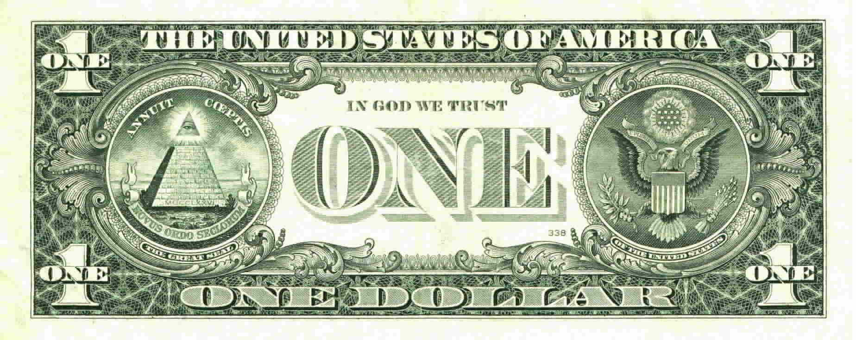
[KJV+] 2 Corinthians 5: 17 Therefore if any man be in Christ, he is a new creature:
old things are passed away; behold all things are become new
[KJV+] 1 Peter 2:7 Unto you therefore which believe precious:
but unto them which be disobedient, the stone which the builders
disallowed, the same is made the head of the corner,
We are not talking about a pyramis but of the Temple
NIV
Capstone
1

Slide 105
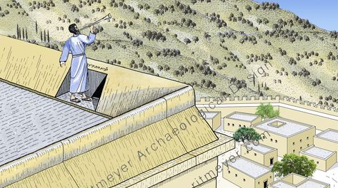
1

Slide 106
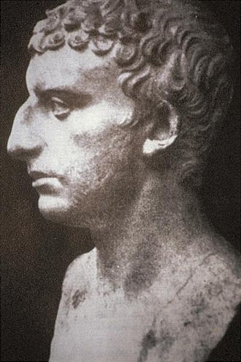
Josephus IV:9:1
Above the roof of the priests’ chambers, . . . it was the custom for one of the priests to stand and to give notice, by sound of trumpet, in the afternoon of the approach, and on the following evening of the close, of every seventh day, announcing to the people the respective hours for ceasing work and for resuming their labors.
1

Slide 107
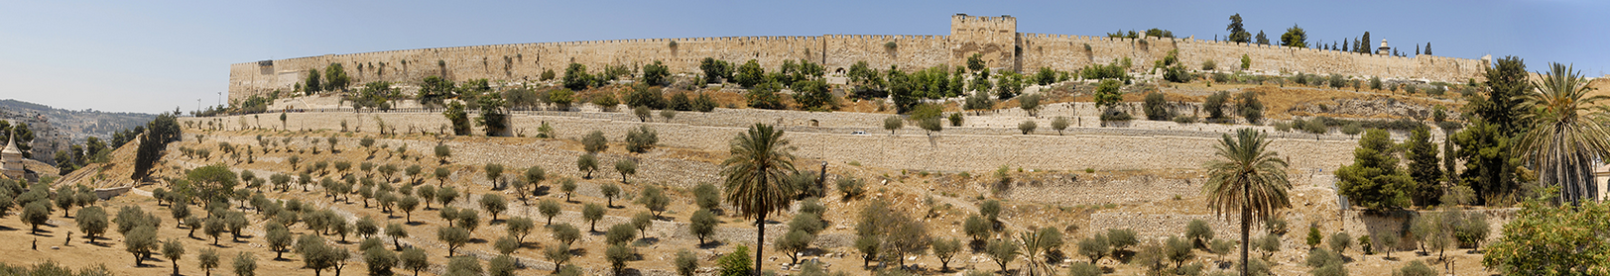
1

Slide 108
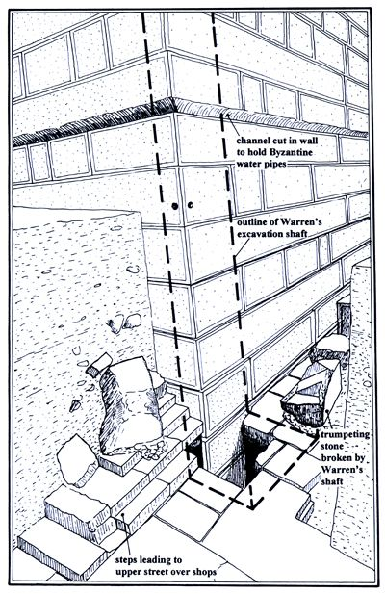
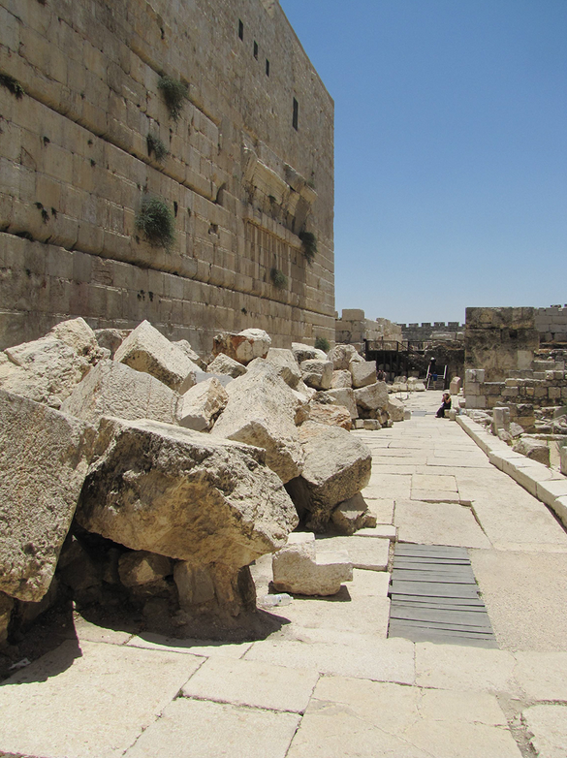
1

Slide 109
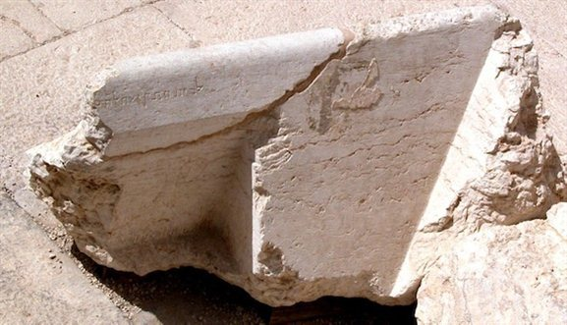
Trumpeting place
“For the place of trumpeting to . . .”
1

Slide 110
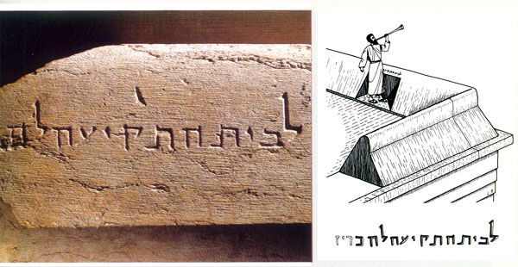
1

Slide 111
[KJV+] Hebrews 9:10 only in meats and drinks, and divers washings, and carnal ordinances, imposed until the time of “reformation”.
Διορθωσεως restoring to a point of time where it was perfect
[NIV] Hebrews 9:10 They are only a matter of food and drink and various ceremonial washings —external regulations applying until the time of the new order.
1

Slide 112
Problems in the KJV
[KJV+] Matthew 23:
1 Then spake Jesus to the multitude, and to his disciples,
2 Saying, The scribes and the Pharisees sit in Moses' seat:
3 All therefore whatsoever they bid you observe, observe and do; but do not ye after their works: for they say, and do not.

Slide 113
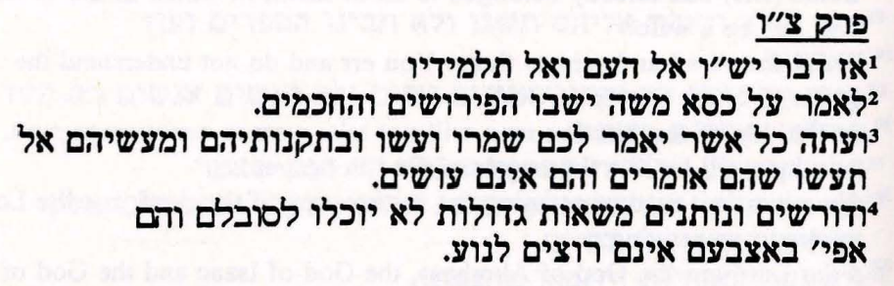
Problems in the KJV
ShemTov from Sepharad (That is Spain) 1375
ו

Slide 114
Problems in the KJV
KJV Mark 4:21
And he said unto them, Is a candle brought to be put under a bushel, or under a bed? and not to be set on a candlestick?
Sepharad Hebrew Mark 4:21
He also said to them, “There is no man who places a burning lamp under the barrel, neither under the bed, but a man places it on the Menorah.

Slide 115
Problems in the KJV
KJV Mark 6:5
And he could there do no mighty work, save that he laid his hands upon a few sick folk, and healed them.
…םוש תושע םש הצר אלואלפ
And he did not want to do any wonder there…

Slide 116
Problems in the KJV
[KJV+] Mat 1:17
So all the generations from Abraham to David fourteen generations; and from David until the carrying away into Babylon fourteen generations; and from the carrying away into Babylon unto Christ fourteen generations.

Slide 117
Problems in the KJV
[KJV+] Mat 1:1-16
[KJV+] Matthew 1:1 The book of the generation of Jesus Christ, the son of David, the son of Abraham. 2 Abraham begat Isaac; and Isaac begat Jacob; and Jacob begat Judas and his brethren; 3 And Judas begat Phares and Zara of Thamar; and Phares begat Esrom; and Esrom begat Aram; 4 And Aram begat Aminadab; and Aminadab begat Naasson; and Naasson begat Salmon; 5 And Salmon begat Booz of Rachab; and Booz begat Obed of Ruth; and Obed begat Jesse; 6 And Jesse begat David (14) the king; and David the king begat Solomon of her of Urias; 7 And Solomon begat Roboam; and Roboam begat Abia; and Abia begat Asa; 8 And Asa begat Josaphat; and Josaphat begat Joram; and Joram begat Ozias; 9 And Ozias begat Joatham; and Joatham begat Achaz; and Achaz begat Ezekias; 10 And Ezekias begat Manasses; and Manasses begat Amon; and Amon begat Josias; 11 And Josias begat Jechonias (14) and his brethren, about the time they were carried away to Babylon: 12 And after they were brought to Babylon, Jechonias begat Salathiel; and Salathiel begat Zorobabel; 13 And Zorobabel begat Abiud; and Abiud begat Eliakim; and Eliakim begat Azor; 14 And Azor begat Sadoc; and Sadoc begat Achim; and Achim begat Eliud; 15 And Eliud begat Eleazar; and Eleazar begat Matthan; and Matthan begat Jacob; 16 And Jacob begat Joseph the husband of Mary, of whom was born Jesus (13), who is called Christ.

Slide 118
Problems in the KJV
Luke 3:23 The Genealogy of Jesus Christ
²³ Jesus, when he began his ministry, was about thirty years of age, being the son (as was supposed) of Joseph, the son of Heli,
Mark 1:16 And Jacob begat Joseph the husband of Mary
Joseph the husband of Mary was the son of Heli not of Jacob
1) Shealtiel, 2) Zerubbabel, 3) Abiud, 4) Eliakim, 5) Azor, 6) Zadok, 7) Akim, 8) Eliud, 9) Eleazar, 10) Mattan, 11) Jacob, 12) Joseph (the father of Mary), 13) Mary, 14) Jesus.

Slide 119
Problems in the KJV
[KJV+] Mat 1:12-16
12 And after they were brought to Babylon, Jechonias begat 1 Salathiel; and Salathiel begat 2 Zorobabel; 13 And Zorobabel begat 3 Abiud; and Abiud begat 4 Eliakim; and Eliakim begat 5 Azor; 14 And Azor begat 6 Sadoc; and Sadoc begat 7 Achim; and Achim begat 8 Eliud; 15 And Eliud begat 9 Eleazar; and Eleazar begat 10 Matthan; and Matthan begat 11 Jacob; 16 And Jacob begat 12 Joseph the husband of 13 Mary, of whom was born Jesus (13), who is called Christ.
husband
14
father
13
13

Slide 120
Problems in the KJV
[KJV+] Mark 1:1
The beginning of the gospel of Jesus Christ, the Son of God;
[Sepharad Hebrew] Mark 1:1
This is the good news of Yeshua Mashiach, the Son of Eloah.

Slide 121
Problems in the KJV
From the Introduction Hebrew Gospel of Mark
The Hebrew Gospels from Sepharad are the most interesting and amazing
versions of the Gospels that we know of. They are full of insights into the original meaning of Yeshua’s life and teaching, and help to solve certain contradictions found in the Greek New Testament tradition.
For example, according to the Greek manuscript tradition, Mark begins with: “The beginning of the gospel of Jesus Christ, the Son of God.”
If this was the “beginning of the gospel,” then what about Old Testament believers? Did they never hear the Gospel? In the Greek tradition, Mark 1:1 is a good ‘proof’ text for dispensationalism – that supposedly there was no Gospel in the Old Testament, but that the New Testament is where and when the new dispensation of grace (and the Gospel) began!?

Slide 122
Problems in the KJV
In Revelation, the New Testament clearly teaches that the Gospel is eternal. In fact, the book of Hebrews records that the Gospel was preached to the Israelites in the wilderness: “For unto us was the gospel preached, as well as unto them…” In context, Paul is clearly speaking about the Israelites in the wilderness, so how could the “beginning of the gospel” be in the first century C.E.?
The Hebrew version of Mark, contained in Vat Ebr.. 100 solves the problem! It reads: “This is the Gospel of Yeshua Mashiach, the son of Eloah.” Thus the Hebrew Gospel of Mark says nothing of the like. This was not the beginning of the Gospel, but rather the fulfillment of the eternal Gospel as it was prophesied and proclaimed (preached) since the beginning of the world.

Slide 123
Problems in the KJV
[TR+] Luk 24:1 τη δε μια των σαββατων ορθρου βαθεος ηλθον επι το μνημα φερουσαι α ητοιμασαν αρωματα και τινες συν αυταις
[TR+] Joh 20:1 τη δε μια των σαββατων μαρια η μαγδαληνη ερχεται πρωι σκοτιας ετι ουσης εις το μνημειον και βλεπει τον λιθον ηρμενον εκ του μνημειου
[TR+] Joh 20:19 ουσης ουν οψιας τη ημερα εκεινη τη μια των σαββατων και των θυρων κεκλεισμενων οπου ησαν οι μαθηται συνηγμενοι δια τον φοβον των ιουδαιων ηλθεν ο ιησους και εστη εις το μεσον και λεγει αυτοις ειρηνη υμιν
[TR+] Act 20:7 εν δε τη μια των σαββατων συνηγμενων των μαθητων του κλασαι αρτον ο παυλος διελεγετο αυτοις μελλων εξιεναι τη επαυριον παρετεινεν τε τον λογον μεχρι μεσονυκτιου
[Lut1545+] Lukas 24:1 Aber an der Sabbate einem sehr frühe kamen sie zum Grabe und trugen die Spezerei , die sie bereitet hatten, und etliche mit ihnen.
[Lut1545+] Johannes 20:1 An der Sabbate einem kommt Maria Magdalena früh , da es noch finster war , zum Grabe und siehet, daß der Stein vom Grabe hinweg war .
[Lut1545+] Johannes 20:19 Am Abend aber desselbigen Sabbats , da die Jünger versammelt und die Türen verschlossen waren aus Furcht vor den Juden , kam JEsus und trat mitten ein und spricht zu ihnen : Friede sei mit euch !
[Lut1545+] Apostelgeschichte 20:7 Auf einen Sabbat aber , da die Jünger zusammenkamen , das Brot zu brechen , predigte ihnen Paulus und wollte des andern Tages ausreisen und verzog das Wort bis zu Mitternacht .

Slide 124
Problems in the KJV
[KJV+] Luke 24:1 Now upon the first of the week, very early in the morning, (πολύ νωρίς το πρωί שְׁכֵּ֣ם get up) they came unto the sepulchre, bringing the spices which they had prepared, and certain with them.
[KJV+] John 20:1 The first of the week cometh Mary Magdalene early, when it was yet dark, unto the sepulchre, and seeth the stone taken away from the sepulchre.
[KJV+] John 20:19 Then the same day at evening, being the first of the week, when the doors were shut where the disciples were assembled for fear of the Jews, came Jesus and stood in the midst, and saith unto them, Peace unto you.
[KJV+] Acts 20: 7 And upon the first of the week, when the disciples came together to break bread, Paul preached unto them, ready to depart on the morrow; and continued his speech until midnight.

Slide 125
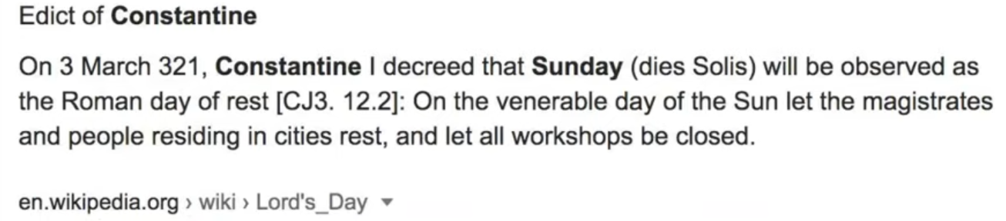
Problems in the KJV
“Question – Why do Catholics observe Sunday instead of Saturday?
because the Catholic Church, in the Council of Laodicea (A.D. 364), has transferred the solemnity from Saturday to Sunday.”
“Answer: Had she not such power, she could not a done that in which all modern religionists agree with her; -she could not have substituted the observance of Sunday the first day of the week, for the observance of Saturday the seventh day of the week, a change for which there is no Scriptural authority.” — Stephen Keenan, A Doctrinal Catechism On
the Obedience Due to the Church, 3rd edition, Chapter 2, p. 174 (Imprimatur, John Cardinal McCloskey, Archbishop of New York).

Slide 126
John 1:1-5
Problems in the KJV
¹ In the beginning was the Word, and the Word was with God, and the Word was God. ² The same was in the beginning with God. ³ All things were made by him; and without him was not any thing made that was made. ⁴ In him was life; and the life was the light of men. ⁵ And the light shineth in darkness; and the darkness comprehended it not.
¹ In the beginning the Son was Eloah. The Son of El was both with El, and the Son of El was Eloah. ² This one was in the beginning with El. ³ All things were made by him; and without him nothing was made, of that which was made. ⁴ For he is life — this life is the lamp of men. ⁵ And the lamp does shine in the gloom; but the gloom and darkness do not have power over it.

Slide 127
Problems in the KJV
KJV John 1:10 “He was in the world, and the world was made by him, and the world knew him not.”
Sepharad Hebrew John 1:10 “He is eternal (Olam); and the world (Olam) was made by him; but the world (Olam) does not recognize him…”

Slide 128
Problems in the KJV
By adding the verse John 6,4
that never was in the early manuscripts, a 3 years ministry of Jesus was willingly created and the 70 weeks ministry of Yeshua denied.
Luke 4:19 To preach the acceptable year of the Lord.
Isaiah 61:2 To proclaim the acceptable year of the LORD, and the day of vengeance of our God; to comfort all that mourn;

Slide 129
Problems Hebrew Manuscpits
HEBREW MATTHEW
Shem Tob - du Tillet – Münster – Martini
1
These are mainly found in Jewish apologetic writings.
They are from about 1350 A.D. to 1400 A.D. from France and Spain
and tent to be polemic and omit that Jesus is the Messiah
The Hebrew Texts from Sepharad are translated from the Catalan language but pretty precise and from native Hebrew Believers in the Messiah.
Still they miss some info
2

Slide 130
Hebrew Manuscpits
The greatest treasures are still the sectarian scrolls of Qumran 737 Scrolls of exact writings from the supervision of Jochanan Ben Sacharia (John the Baptist)
3
Also at the Bar Ilan University in Tel Aviv with an outpost at the Hebrew University of Jerusalem is a database of about 100,000 Hebrew manuscripts that were scanned into a computer. These were in Jewish possession and had never been translated. They survived the changes of the Romans. Among those are also writing from the New Testament.
4

Slide 131
And Elijah came unto all the people, and said, How long halt ye between two opinions? if YeHoWaH is God, follow him: but if Baal, follow him. And the people answered him not a word.
1 Kings 18:21

