Slide 1
Anthropology
Origin, Ethnology, Function, Birth, Life, Death

Slide 2


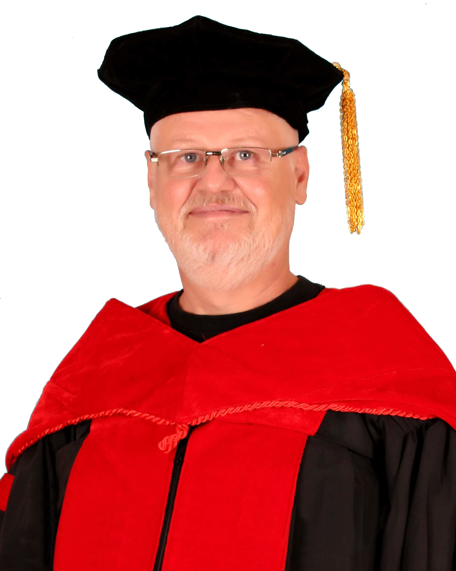

Slide 3
Marking
Physical
Spiritual
βίο Bio
Ζώη Zoe
Emotional
wrong
Ψύχε Psyche

Slide 4

The bible begins with a wedding

Slide 5


The bible begins with a wedding

Slide 6


Until this happened

Slide 7
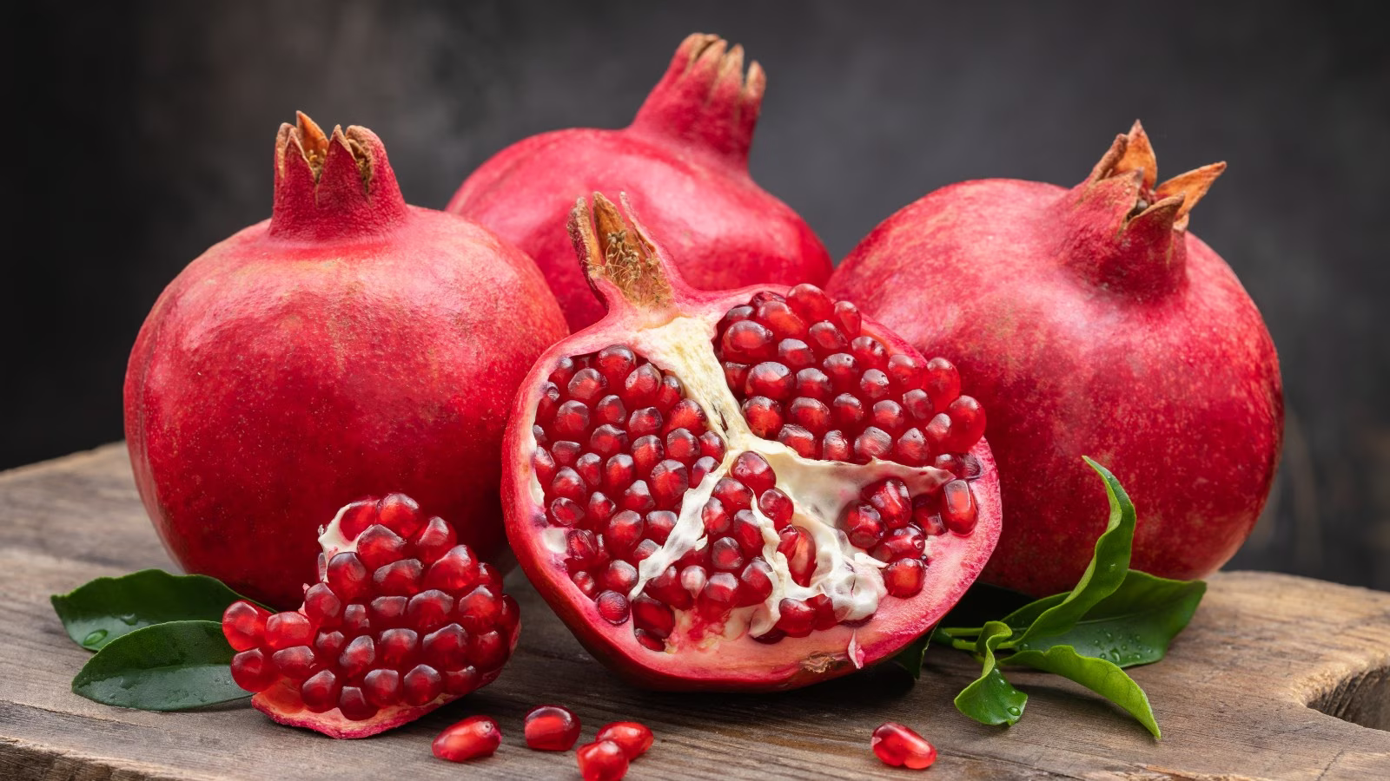

Slide 8
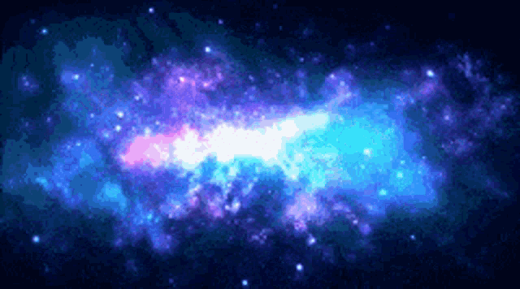

January February March April May June July August Septemb October November December
Aviv Ziv Sivan Revii Chamishi Elul Etanim Bul Chisleu Tevet Shevat Adar
Spring Mid Spring Late Spring Summer Mid Summer Late Summer Autumn Mid Autumn Late Autumn Winter Mid Winter Late Winter
Shmita leap
Nourish Tend Grain Vines Olives Plant Water
spring Equinox / Tekufa
Burning leaven
50 days 50 days 50 days 50 days 50 days 50 days 50 days
Barley Harvest
Winter Spring Summer Autumn
Wheat Harvest
Tekufa / Winter Solstice
Summer Solstice / Tekufa
Burning Old Vine
New Wine
Wood Offering
Autumn Equinox / Tekufa
New Oil

Slide 9
Called to fellowship
Gen 1:27 God created man in his own image
See also Isa 43:7 und Col 1:16.

Slide 10
Called to eternal life
Gen 2:17 but you must not eat from the tree of the knowledge of good and evil, for when you eat of it you will surely die.
Called to rule

Slide 11
Called to rule
Gen 1:28 ...be fruitful and increase in number; fill the earth and subdue it. Rule over the fish of the sea and the birds of the air and over every living creature that moves on the ground.

Slide 12
Creation in 6 days: 24-hour-days or “period-days”?
To adapt to so-called science many interpreters (also Evangelicals) construe the days of creation in Gen 1 as creation-periods. Among others the following two facts seem to motivate this interpretation:
1. The Darwinist evolution-theory demands long intervals of time.
2. The claim of modern science, apparently proving that the earth, i.e. the universe, is billions of years old.

Slide 13
for the period-days-hypothesis
Evangelical theologians who hold a day-period-hypothesis insist that this interpretation (literary, poetical) does not impinge on the inerrancy and inspiration of the Bible. There are many representatives of the authority and inerrancy of Holy Scripture who support the day-periodhypothesis. Here two of their arguments:
1. The Hebrew word “yōm” (~Ay) is not only used for a 24-hour-day but can also refer to a period or an epoch (comp. for instance: day of salvation, day of judgement…).

Slide 14
2. On the 6th day, God created the animals on the ground and also man (cf. Gen 1:24ff). According to the text, they were created on one and the same day: the animals of the field, man and woman. In Gen 2:18ff, Adam should have given names to all the animals, before he became conscious of being alone, i.e. without a partner. God then caused a deep sleep to fall upon Adam, took one of his ribs out of which he created Eve. Advocates of the “day-period hypothesis” say it would have been impossible for all this to happen on one day. For the naming of animals alone, Adam would have needed months or even years.
Notes:
4 h 38 min that mean 5 seconds for every animal

Slide 15
How it was looking t name the animals we do not know and if Adam named the Animals like Noah had the help of GOD to bring All wanted animals to him. Adam could have named 1.000.000 Animals taking 5 seconds each.
Oe things remains with all those not believing the biblical text literally.
They make the power of GOD lesser as they are limited themselves. Still, it was SUPERNATURALLY created.

Slide 16
for a creation in six 24-hour-days
1. The expression and there was evening and there was morning speaks against an interpretation of periods. As mentioned, it is a fact that the Hebrew word yōm can mean something other than a day of 24 hours (e.g. day of salvation). Compare also Gen 7:11 where it speaks of years, months and days in the usual meaning of the words concerned.

Slide 17
for a creation in six 24-hour-days
2. In Gen 1:14-18, it speaks of lights that divide day and night and determine festivals, days and years. What if these festivals should last for millions of years?

Slide 18
for a creation in six 24-hour-days
3. On the 3rd day plants, trees etc. were created (Gen 1:9-13). How should these have survived without the sun, which was only created on the 4th day if (as supporters of the “day-period hypothesis” claim) these days of creation have to be understood as (long) periods? However, we admit that for the photosynthesis the presence of the sun is not in all cases absolutely indispensable. The plants use the energy of the light (of different kinds of sources of light) for the photosynthesis. According to Gen 1, the light was present right from the beginning (i.e. since the first day of creation). – However, an earth without sun, during billions of years, would be an earth without possibility of “life”!

Slide 19
for a creation in six 24-hour-days
4.A. The pollination of many plants is by insects. According to Gen 1, plants were already created on the 3rd day, but insects not before the 6th day. If the days of creation should be long periods, it remains unexplained how plants, dependent on insects, could survive their long absence. Against this argument the supporters of the day-period-hypothesis reply that the 6 days of creation (for them periods of creation) need not necessarily be understood chronologically time wise. The sequence of the six days is to be explained as poetical style. In view of the divine reason for the Sabbath law in Exo 20:11, this explanation is very questionable.

Slide 20
for a creation in six 24-hour-days
4.B Apropos Exo 20:11: If one alleges that certain fish were living on insects right from the beginning of the creation (which we doubt, because of Gen 1:30) and not only after the entry of sin and death into the world because of Adam’s sin (cf. Rom 5:12; Gen 3), then the “day-period-hypothesis” is even more problematic because, according to Gen 1:20-23, the fish and birds were created on the 5th day, whereas the insects were obviously created only on the 6th day (see Gen 1:24-25). Therefore, if one assumes that there was a gap of millions of years between the 5th and the 6th creation-day, then one would wonder on what those fishes (and birds) were living on in the meantime.

Slide 21
for a creation in six 24-hour-days
5. In the face of these weighty arguments, the advocates of the “day-period-hypothesis” are forced to affirm that the order of the six creation-days (for them of course 6 creation-periods) must not necessarily be interpreted as chronological but could be rather explained by the poetic style of the author. But we cannot accept this objection, otherwise the reason indicated by God for the Sabbath in Exo 20:11 would be incomprehensible. Therefore, the following argument:

Slide 22
for a creation in six 24-hour-days
6. The model for the Sabbath law in Exo 20:11 would be absurd if the days of creation have to be understood as long periods.
7. After all, God only has to speak a word and it happens (cf. Psa 33:9; 147:14-18; Isa 48:13; 50:2; Heb 11:3); he does not need millions of years. It is to be observed that God created man as an adult being. The chicken existed before the egg and the trees were already bearing fruit when they were created. It did not take thousands or millions of years, until the first rays of light reached the earth. God created the stars in such a way that their rays reached the earth from the beginning.

Slide 23
[KJV] Rev 6:13 And the stars of heaven fell unto the earth, even as a fig tree casteth her untimely figs, when she is shaken of a mighty wind.

Slide 24
The origin of Mankind
Many different religions tried to give and explanation of their world view though the one who made it needs to be heard

Slide 25
The races
The whole human race has been created in Adam and multiplies as far as body and soul are concerned through natural procreation called Traducianism
Notes:
Traducianism

Slide 26
The Bible teaches that all man and nations are descended from the first two humans, i.e. from Adam and Eve:
Gen 1:27 ...he created him male and female...
Act 17:26 ...From one man he made every nation of men...

Slide 27
GAP Theory
The Bible knows nothing of a Pre-Adamite (before Adam) or Para-Adamite (beside Adam) race. The unity of the human race is also corroborated by the universality of sin:

Slide 28
Rom 5:12 ...just as sin entered the world through one man...
1Co 15:22 For as in Adam all die...

Slide 29
The races after Noah
Noah gave the post flood race a beautiful touch as his sons Shem, Ham and Japhet were totally different

Slide 30
Races
Semitic Arabs, Israelis
Hamitic African
Japhethitic Caucasian

Slide 31
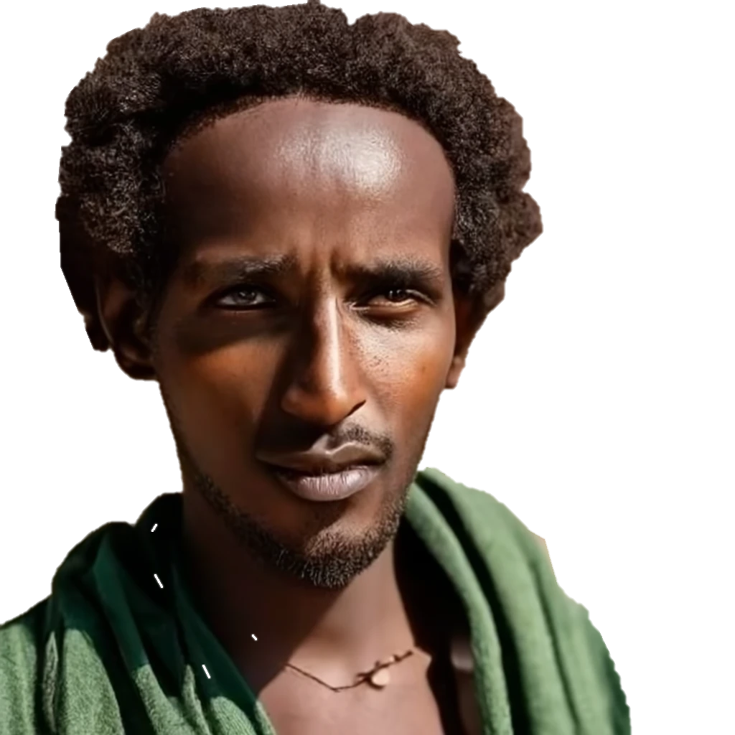



Slide 33
Generations to Yeshua
20 Generations from Adam to Abraham
42 Generations from Abraham to Yeshua
Mat 1:17 So all the generations from Abraham to David fourteen generations; and from David until the carrying away into Babylon fourteen generations; and from the carrying away into Babylon unto Christ fourteen generations.

Slide 34
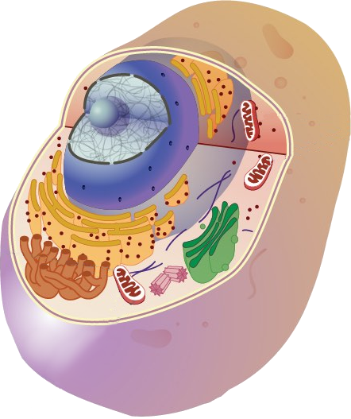
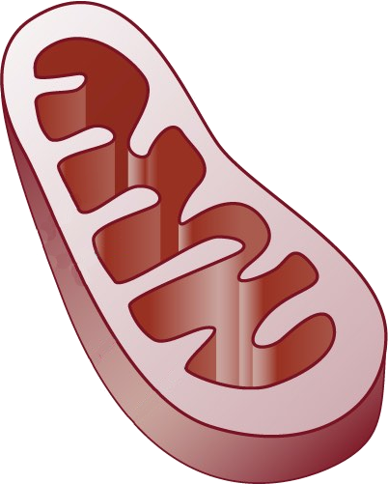
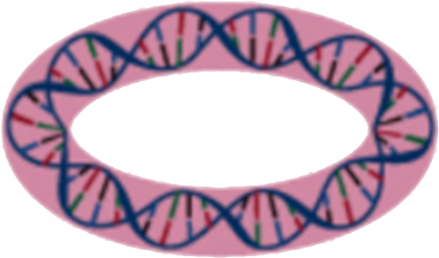
Cell
Mitochondria
Mitochondrial DNA

Slide 35
Mutation rate ≈ every 3. Gen.
M
M
M
M
This is the possibility
to reconstruct the
family trees
M

Slide 36
Biblical Human mtDNA History
32 - 36 mutations
47 - 76 primary branches
Europe
Africa
Asia
nodes
Deep notches
branching
1/32 up to 1/12
From the nodes
3 nodes
3 mutations apart

Slide 37
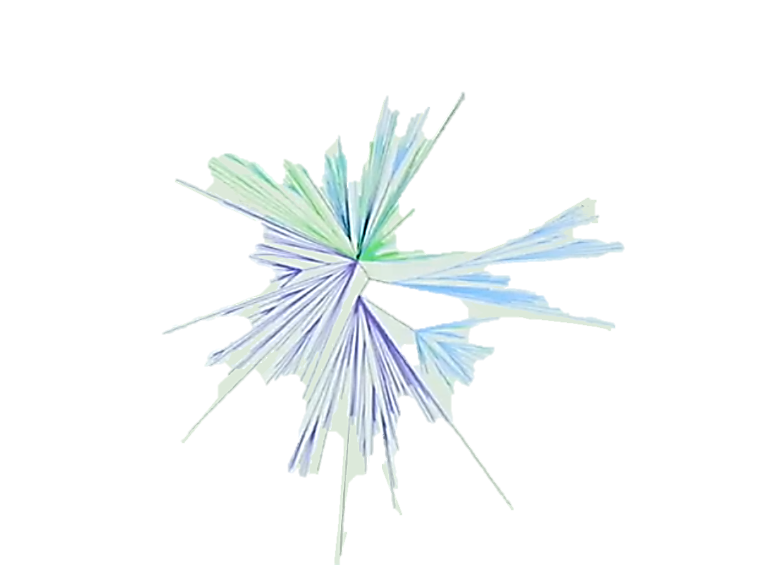
Europe
Asia
Africa

Slide 38
Expectation and truth

Slide 39
Expectations of the major world views
Evolution teaches many
thousands of generations in
succession and a mutation that
can create intelligent codes

Slide 40
Growth of a E.coli bacterium
(Generation time of 1-hour, initial cell number = 1)
20.000.000
Number of Cells
18.000.000
16.000.000
14.000.000
12.000.000
10.000.000
8.000.000
6.000.000
4.000.000
2.000.000
0
1
2
3
4
5
6
7
8
9
10
11
12
13
14
15
16
17
18
19
20
21
22
23
24
Hours

Slide 41
Biblical Human mtDNA History
The Beginning with חַוָּה Khawah 6000 Years ago
Increase of Population to 10 – 14 genertion
3 females left after the flood
Increase of Population to 4 – 12 generation to Babel
Migration of Nations to 47 – 75 Families
Increase of Population to 134 – 156 generations
1000
2000
3000
4000
5000
6000

Slide 42
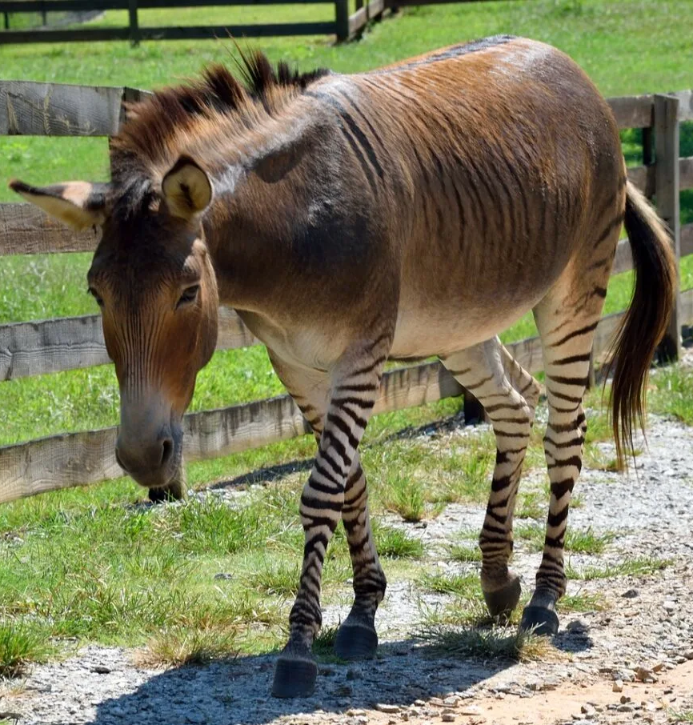
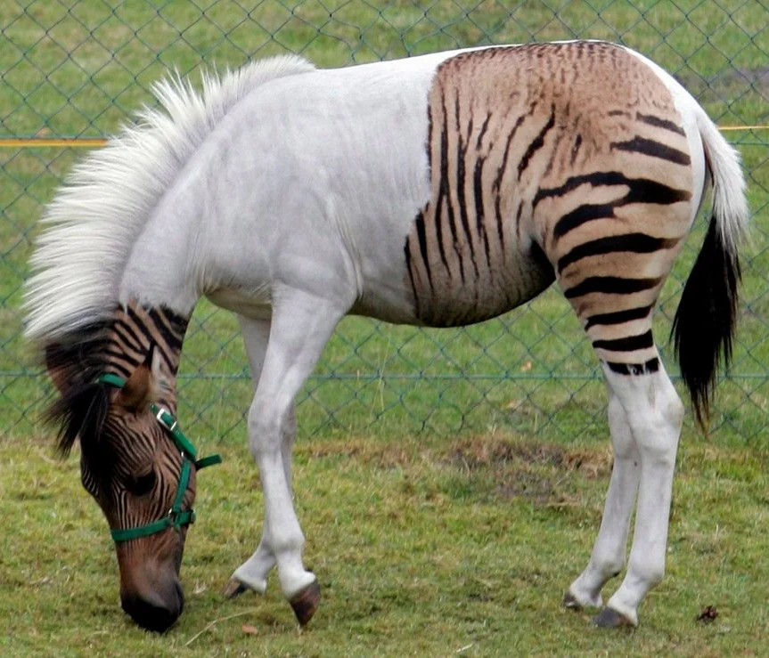
Every animal in its kind

Slide 43
If there are borders of interbreeding with Animals then there is no possibility that mankind came from a different species

Slide 44

This happens only with Gen’manipulation

Slide 45
THE INNER HUMAN

Slide 46
Dichotomous view
This view holds the duality of man - that spirit and soul are one and the same thing, that man isn't a trinity but just two parts. They base their view upon the many passages, which use the word ‘soul’ to signify all of the immaterial part of man, such as the one considered above. It is true that soul is used sometimes to signify this part of man and sometimes spirit. In the light of two or more passages clearly separating them these passages must be considered as merely using the term soul or spirit in a plural sense to signify the whole immaterial nature of man. Such are the terms "Lose your soul." Soul here must mean all of the immaterial part of man in contrast to death of the body. (Also the usage of "spirit man" in Ecclesiastes 3:21 for all of man's immaterial or spiritual nature.)

Slide 47
THE NATURE OF MAN
Body
Soul & Spirit

Slide 48
The fight of spirit and soul at GODs word
Heb 4:12 For the word of God quick, and powerful, and sharper than any twoedged sword, piercing even to the dividing asunder of soul and spirit, and of the joints and marrow, and a discerner of the thoughts and intents of the heart.

Slide 49
Spirit comes with Information
Eph 6:17 And take the helmet of salvation, and the sword of the Spirit, which is the word of God:

Slide 50
Transmission of information
Lets marry and
have children
Transmitted Information
Intended Purpose
Apobetics
Achieved Result
Received Information
Expected Action
Pragmatics
Implemented Action
I give you a kiss
Communicated Ideas
Semantics
Understood Meaning
OH you love me
Code Employed
Syntax
Understood Code
I Love You
Transmitted Signal
Statistic
Received Signal
1I1L2o1v1e2 1Y1u
Sender
Recipient
Transmission of Information
With agreed letters
Notes:
Spiritual

Slide 51
Trichotomous view
THE real NATURE OF MAN
Body
Soul
Spirit
Holy Spirit
Notes:
[FV] James 2:26 For as the body without the spirit is dead, in the same way also, faith without works is dead.

Slide 52
1Co 6:19 Do you not know that your body is a temple of the Holy Spirit, who is in you, whom you have received from God?

Slide 53
The origin of the soul
God has made Soul and spirit of men in Eternity. In the Heavenly Jerusalem our mother, in Yeshua. They had not feelings ever and no memory.
So also, no conciseness

Slide 54
Then GOD blew this life into ADAM and He became alive with all life in himself, “in his loins” waiting for the day of their birth.

Slide 55
The Human members
Our tipple Intelligence
Physical
Spiritual
βίο Bio
Ζώη Zoe
Emotional
Ψύχε Psyche

Slide 56
Spiritual Intelligence
Definition:
SI is the ability to deal with information and understand the purpose of it.

Slide 57




Compare Mobile Phone
When you
delete an APP
The weight is
still the same

Slide 58
2nd Nature law of Information
Information is a non-material fundamental entity and not a property of matter

Slide 59
9th Nature law of Information
Any given chain of information can be traced back to an intelligent source

Slide 60
Creation
The creation can be traced back to the creator

Slide 61
THE CONNECTION
Body and Soul

Slide 62
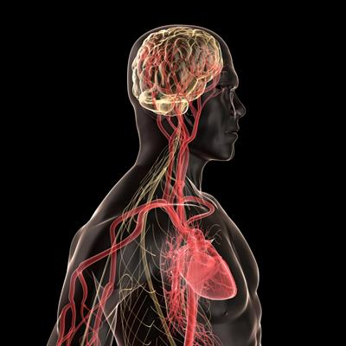
Heart Brain Connection
Mat 15:19 For out of the heart come evil thoughts...

Slide 63
Mat 15:18 But the things that come out of the mouth come from the heart, and these make a man ‘unclean’.

Slide 64
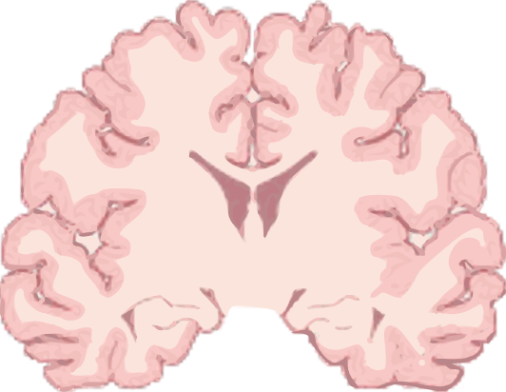
Heart Brain
Connection
Dorsal motor nucleus
of vagus nerve
Cardioaccelerator
centre (sympathetic)
Medulla
Vagus nerve
(parasympathetic)
Cardioinhibitory centre
(parasympathetic)
T1
T2
T3
T4
Pro 16:9 In his heart a man plans his course, but the LORD determines his steps.
T5
SA node
AV node
Cardiac nerve
(sympathetic)

Slide 65
Simon Magus
[KJV+] Acts 8:5 Then Philip went down to the city of Samaria, and preached Christ unto them.
6 And the people with one accord gave heed unto those things which Philip spake, hearing and seeing the miracles which he did.
7 For unclean spirits, crying with loud voice, came out of many that were possessed : and many taken with palsies, and that were lame, were healed.
8 And there was great joy in that city.

Slide 66
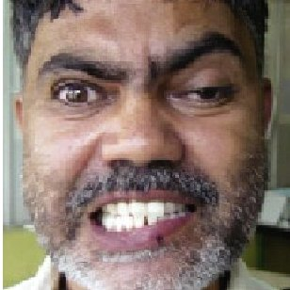
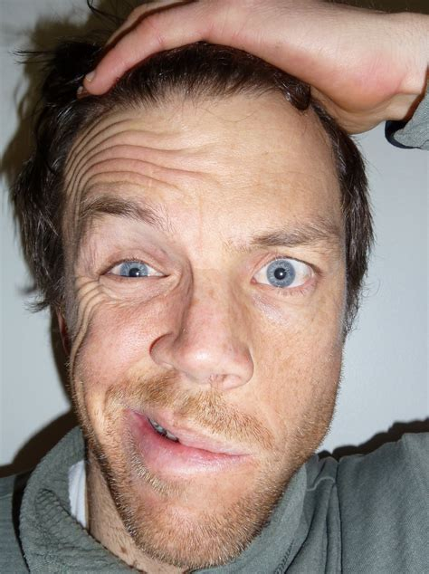

Palsy

Slide 67
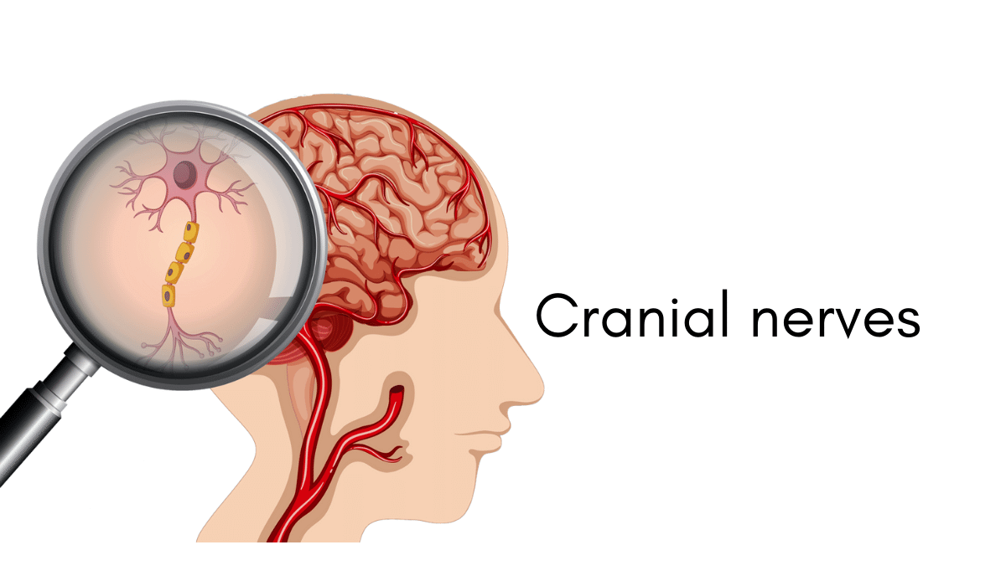
Palsy

Slide 68
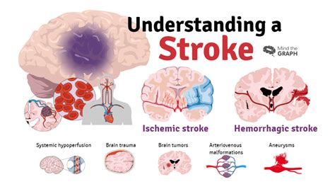
Lame

Slide 69

Spiritual and Emotional
Wellness
Now may the God of peace himself sanctify you completely, and may your whole spirit and soul and body be kept blameless
at the coming of our Lord Jesus Christ.
1 Thessalonians 5:23 ESV

Slide 70
The flesh is the seat of human weakness
Isa 40:6 All flesh is (like) grass
Mat 26:41 The spirit is willing, but the flesh is weak

Slide 71

Baal
Astarte
Moloch
AI
is the connection to the evil spirits the children of the fallen Angels

Slide 72
 | Main Groups in Yeshua time
 | Matters | Pharisees | Essens | Sadducees | Followers of Yeshua
 | Angels | yes | yes | no | yes
 | Behavior | to own friendly | general friendly | rude | general friendly
 | Emphasis | Doctrine/ Tradition | Prophecy | Social | Yeshuas teaching and coming
 | Eternal Life | yes | yes | no | yes
 | Gentile Circumcision | no force | no force | All in Israel | no
 | Messiah as Person | man | God in Flesh | no idea | God in Flesh
 | Messiahs coming | Kingdom | Suffer / Kingdom | no idea | Suffer /Rapture / Kingdom
 | Noahs Law | yes | yes | don't care | somehow
 | Oral Torah | accepted | rejected | rejected | no knowledge
 | Priesthood | Levites | Priests | for all | all Believers
 | Prophets | stoped after Maleachi | continues | stopped after Mose | continues
 | Resurrection | yes | yes | no | yes
 | Ruach HaKodesh | yes | yes | no | yes
 | Spiritual Gifts | stopped after Maleachi | continues | stopped after Mose | continues
 | Top authority | Oral Law | Patriarchs | Governent | Bible / Holy Spirit
 | Writings of Patriarchs | rejected | accepted | rejected | no knowledge
 | Nowadays | Orthodox Jews | have become Christians | changed to Karaite | the same
 | Sects |  | Gnosis | Karaite | many
 | Similarity | Catholic Church | Pentcostals | Johova Witnesses | Born again Christians
1
2
3
4
1
2
3
4

Slide 73
LIFE
Pharisees
The Way
Essens
Saduccees

Slide 74
Death
Ecclesiastes 12:7 And the dust returns to the earth as it was, and the spirit returns to God who gave it.

Slide 75
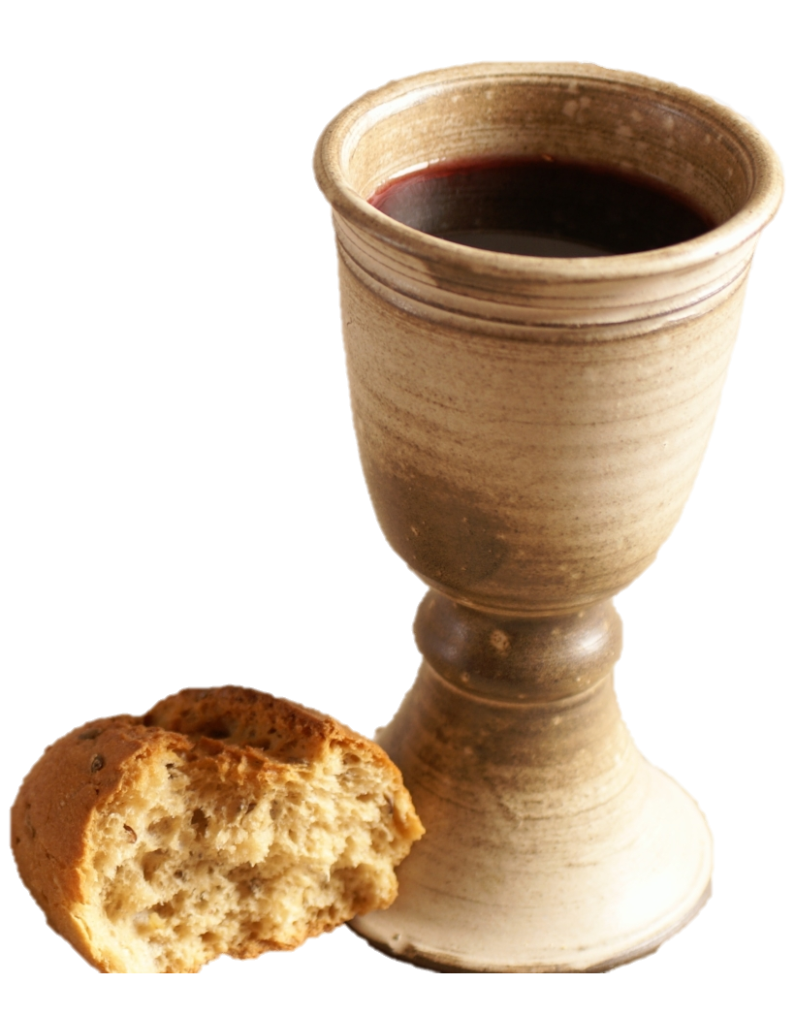


Earth timeline
Pre Flood & Noah
Abraham → Yeshua
Grace
1000
700
700
700
700
700
700
700
700
700
700
1000
2000
3000
4000
5000
6000
7000

Slide 76
 | Improvement and transformation page
 | Character
 | initiative | dependent | conditionally independent | self-sufficient | enterprising | leading
 | sense of responsibility | unreliable | conditionally reliable | reliable | prudent | very conscientious
 | emotional life | unstable | starts balanced | balanced | durable | stable very resilient
 | community behavior | uninvolved | participating | supporting | community spirit | community building
 | classification | rebellious | engaged | recognizing authority | ready to adapt | joyful
 | diligence | powerless | comfortable | willing to work | hard working | very diligent
 | Trim appearance | messy unkempt | indifferent | appropriate to situation | neatly maintained | very neat very well maintained

Slide 77
Possible Disscusion
Adam could have not sinned
Why are we having Adam’s sin?
Why did Satan sin?
Why did God cast Satan upon the earth?
Why did God allow the temptation of man?
A word of Satan ...you will be like God...

